Slide 1
Evapotranspiration in the Congo River Basin
Noel Aloysius
Yale School of Forestry and Environmental Studies
June 07, 2013

Slide 2
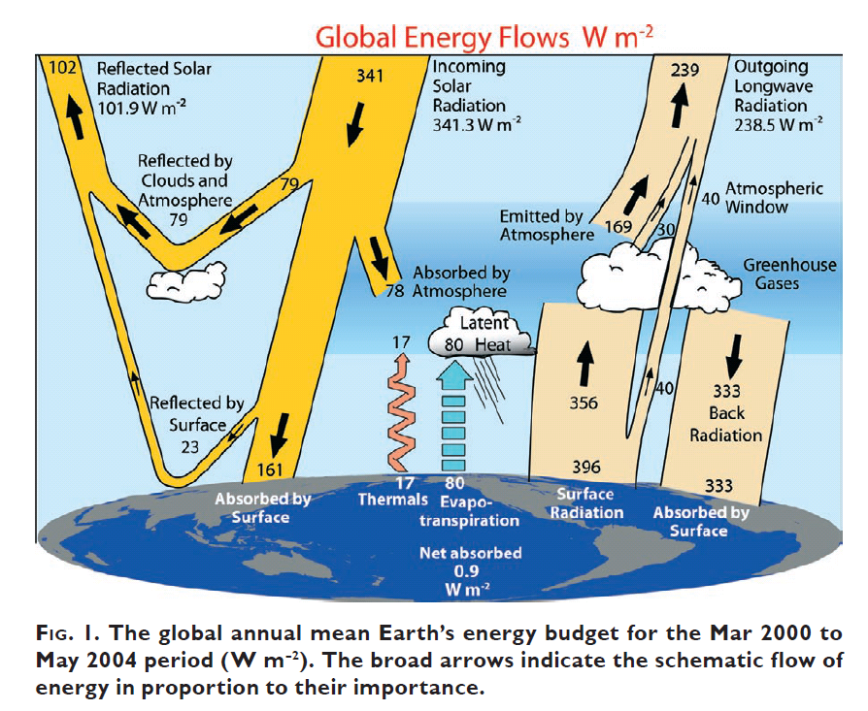
Trenberth, K. E., J. T. Fasullo, et al. (2009). "Earth's Global Energy Budget." Bulletin of the American Meteorological Society 90(3): 311-323.

Slide 3
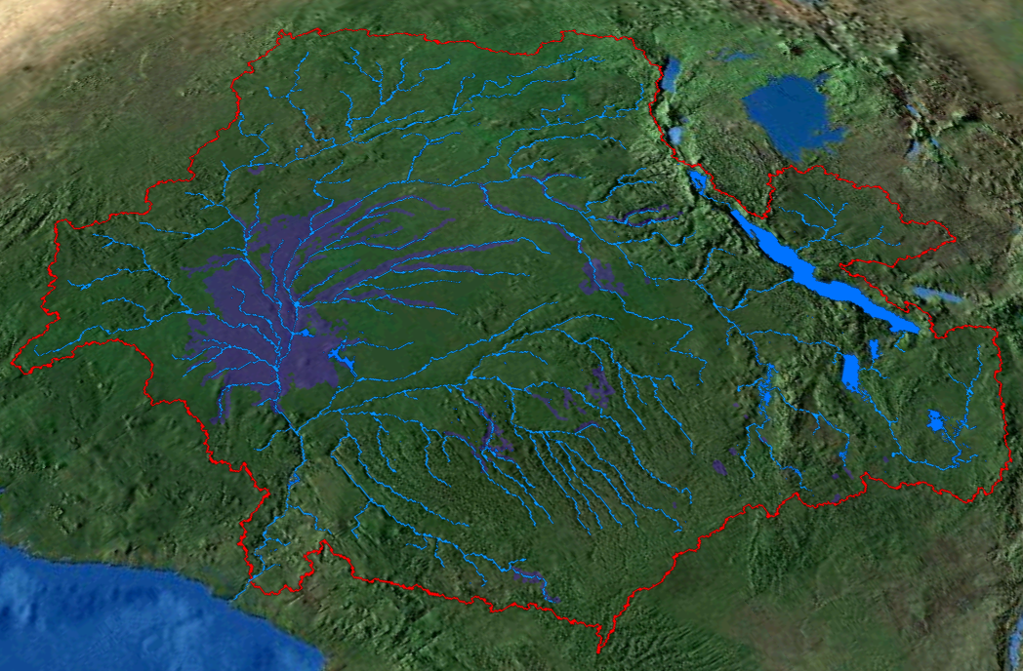
N
Equator

Slide 4
Rainfed agriculture areas (9 classes) developed by IWMI (Birdar et al., 2009)
Purple boxes are cities
Rainfed areas are mostly concentrated in the South

Slide 5
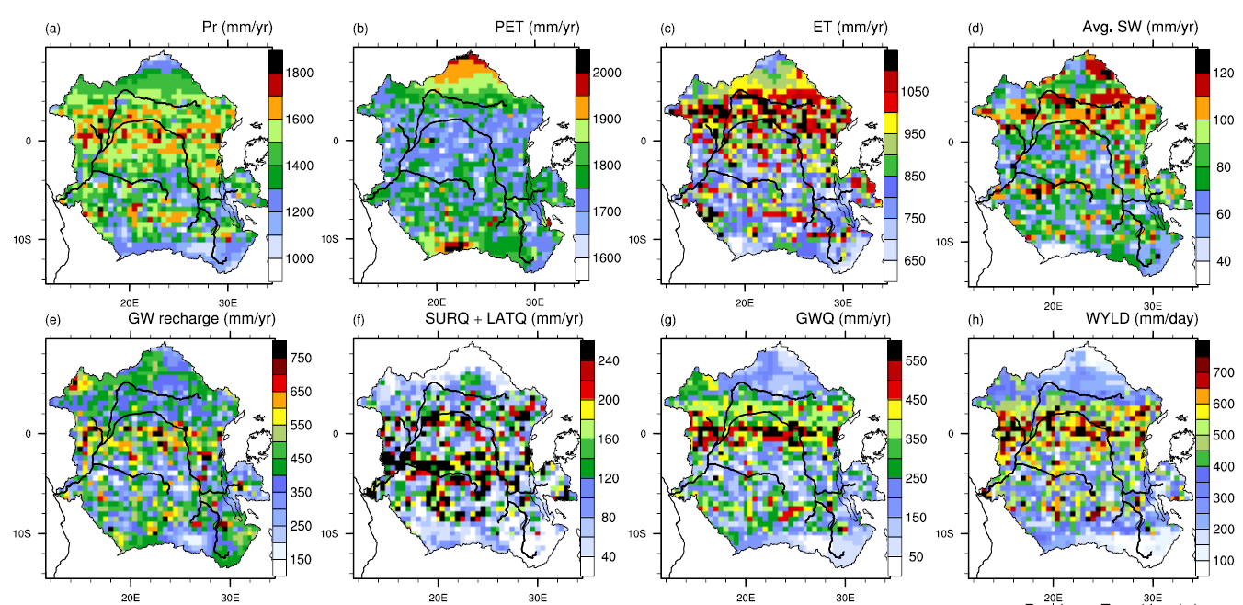
SWAT Water Balance
(1971-2000)

Slide 6
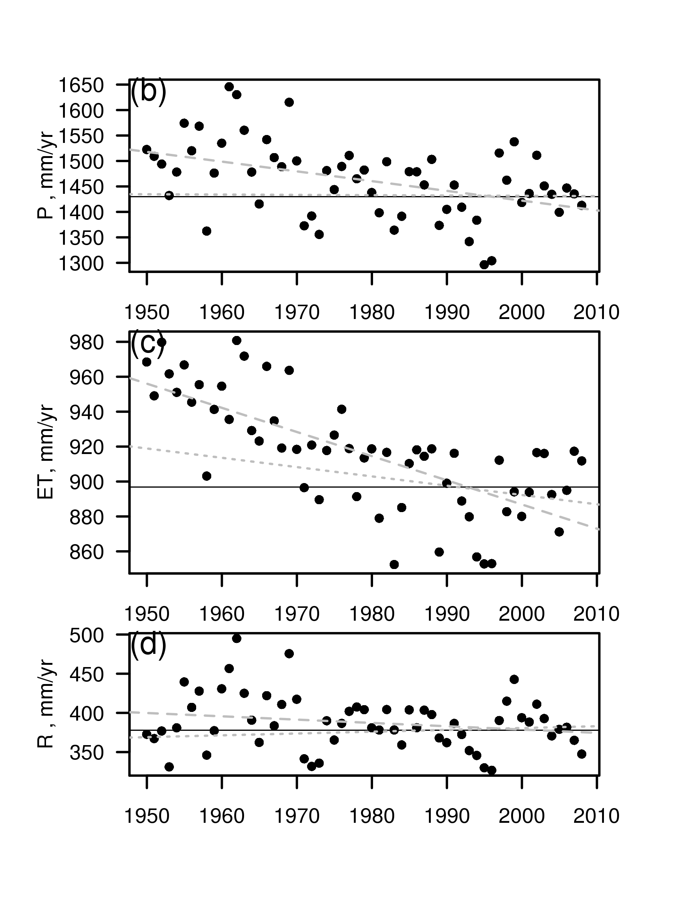
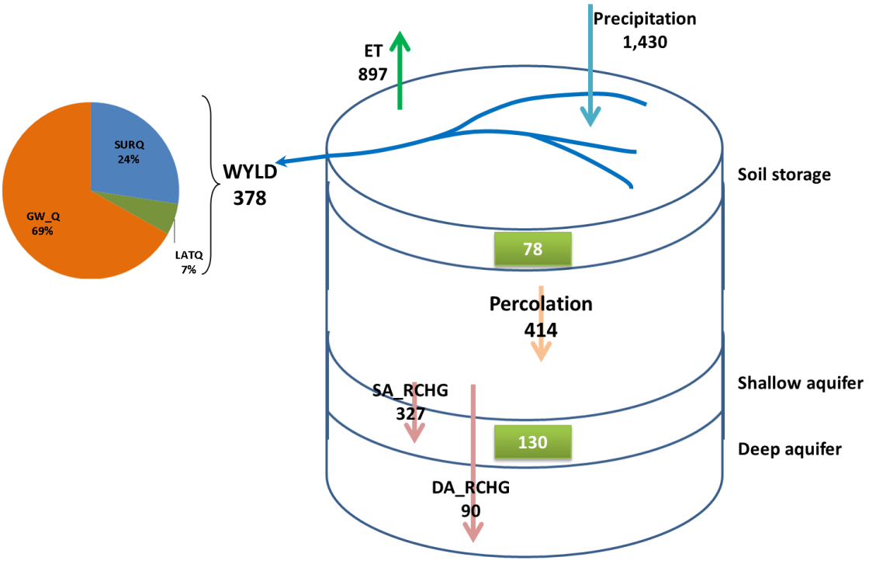
SWAT Water Balance
(1971-2000)
(a)
(values are in mm/year)

Slide 8
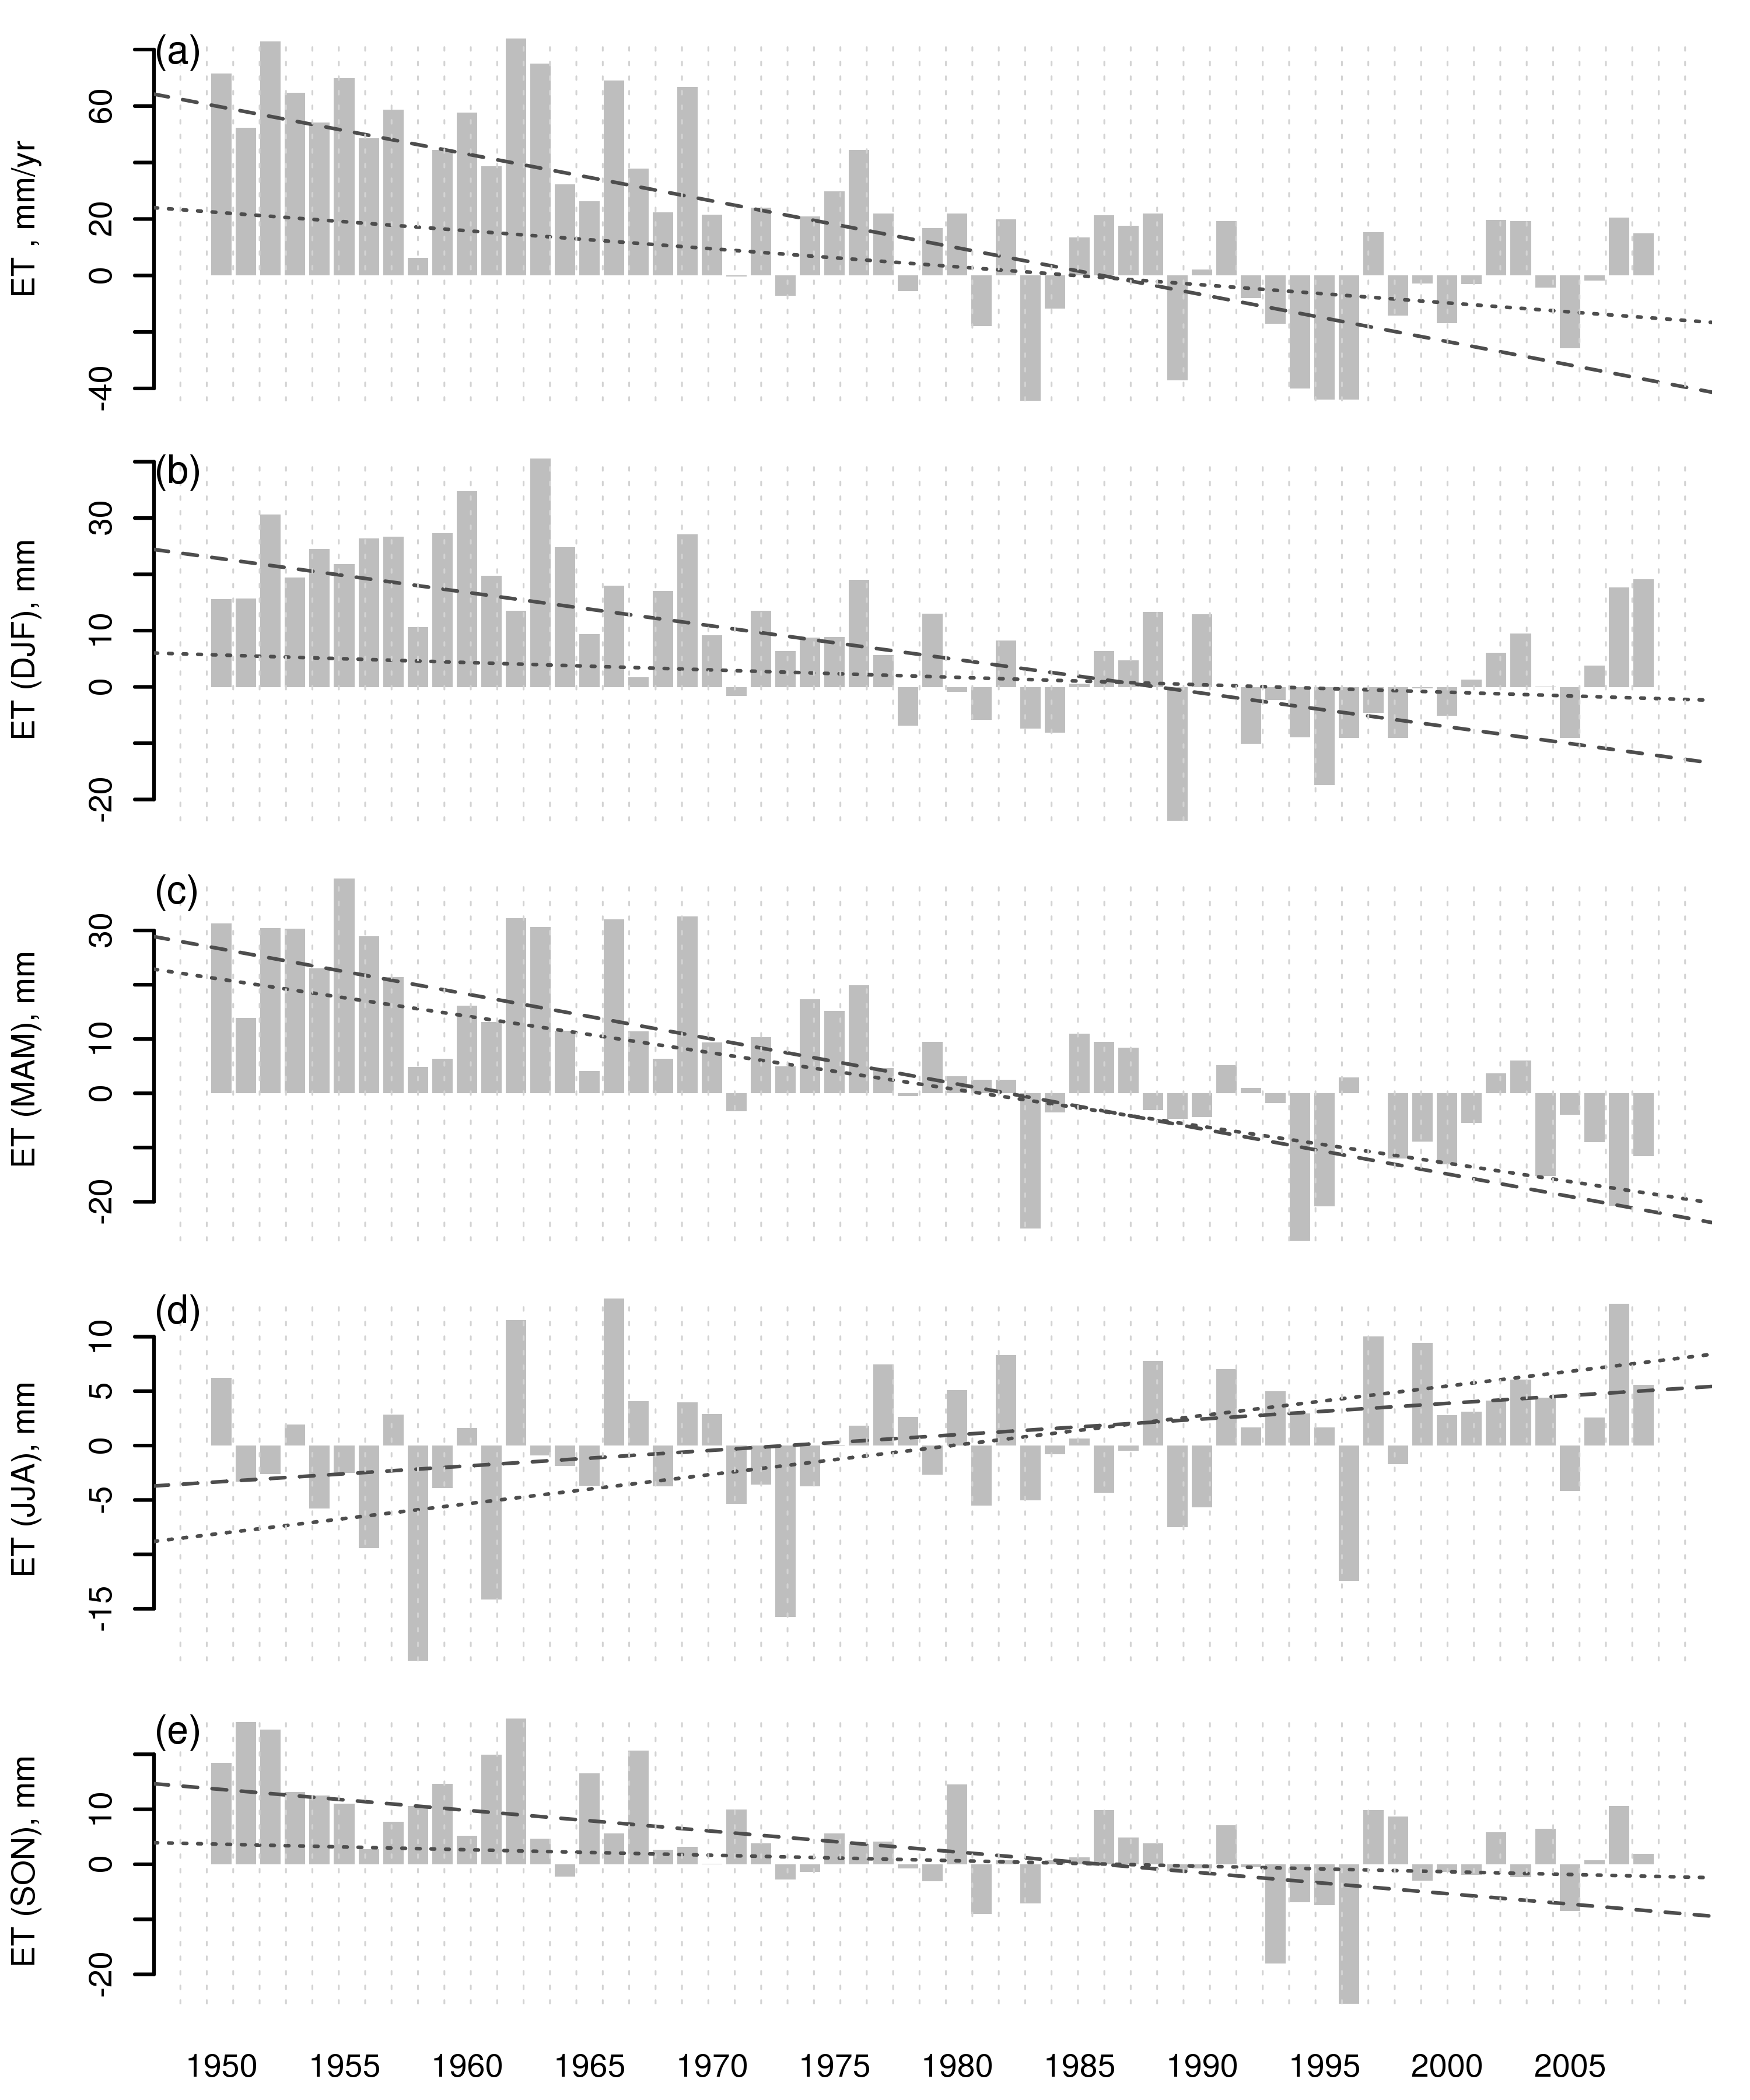
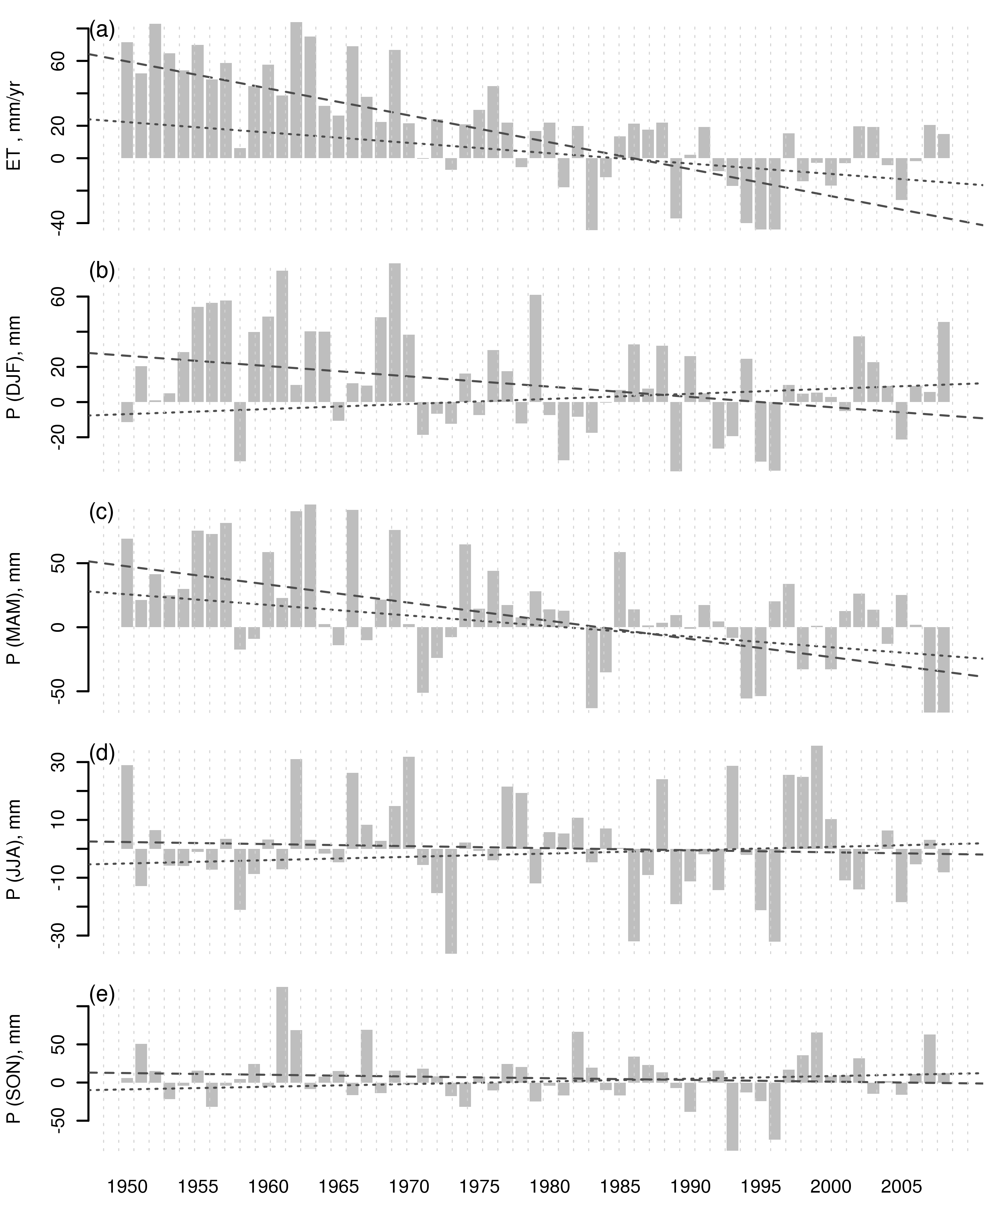
Seasonal ET variation
Seasonal Precipitation variation

Slide 9
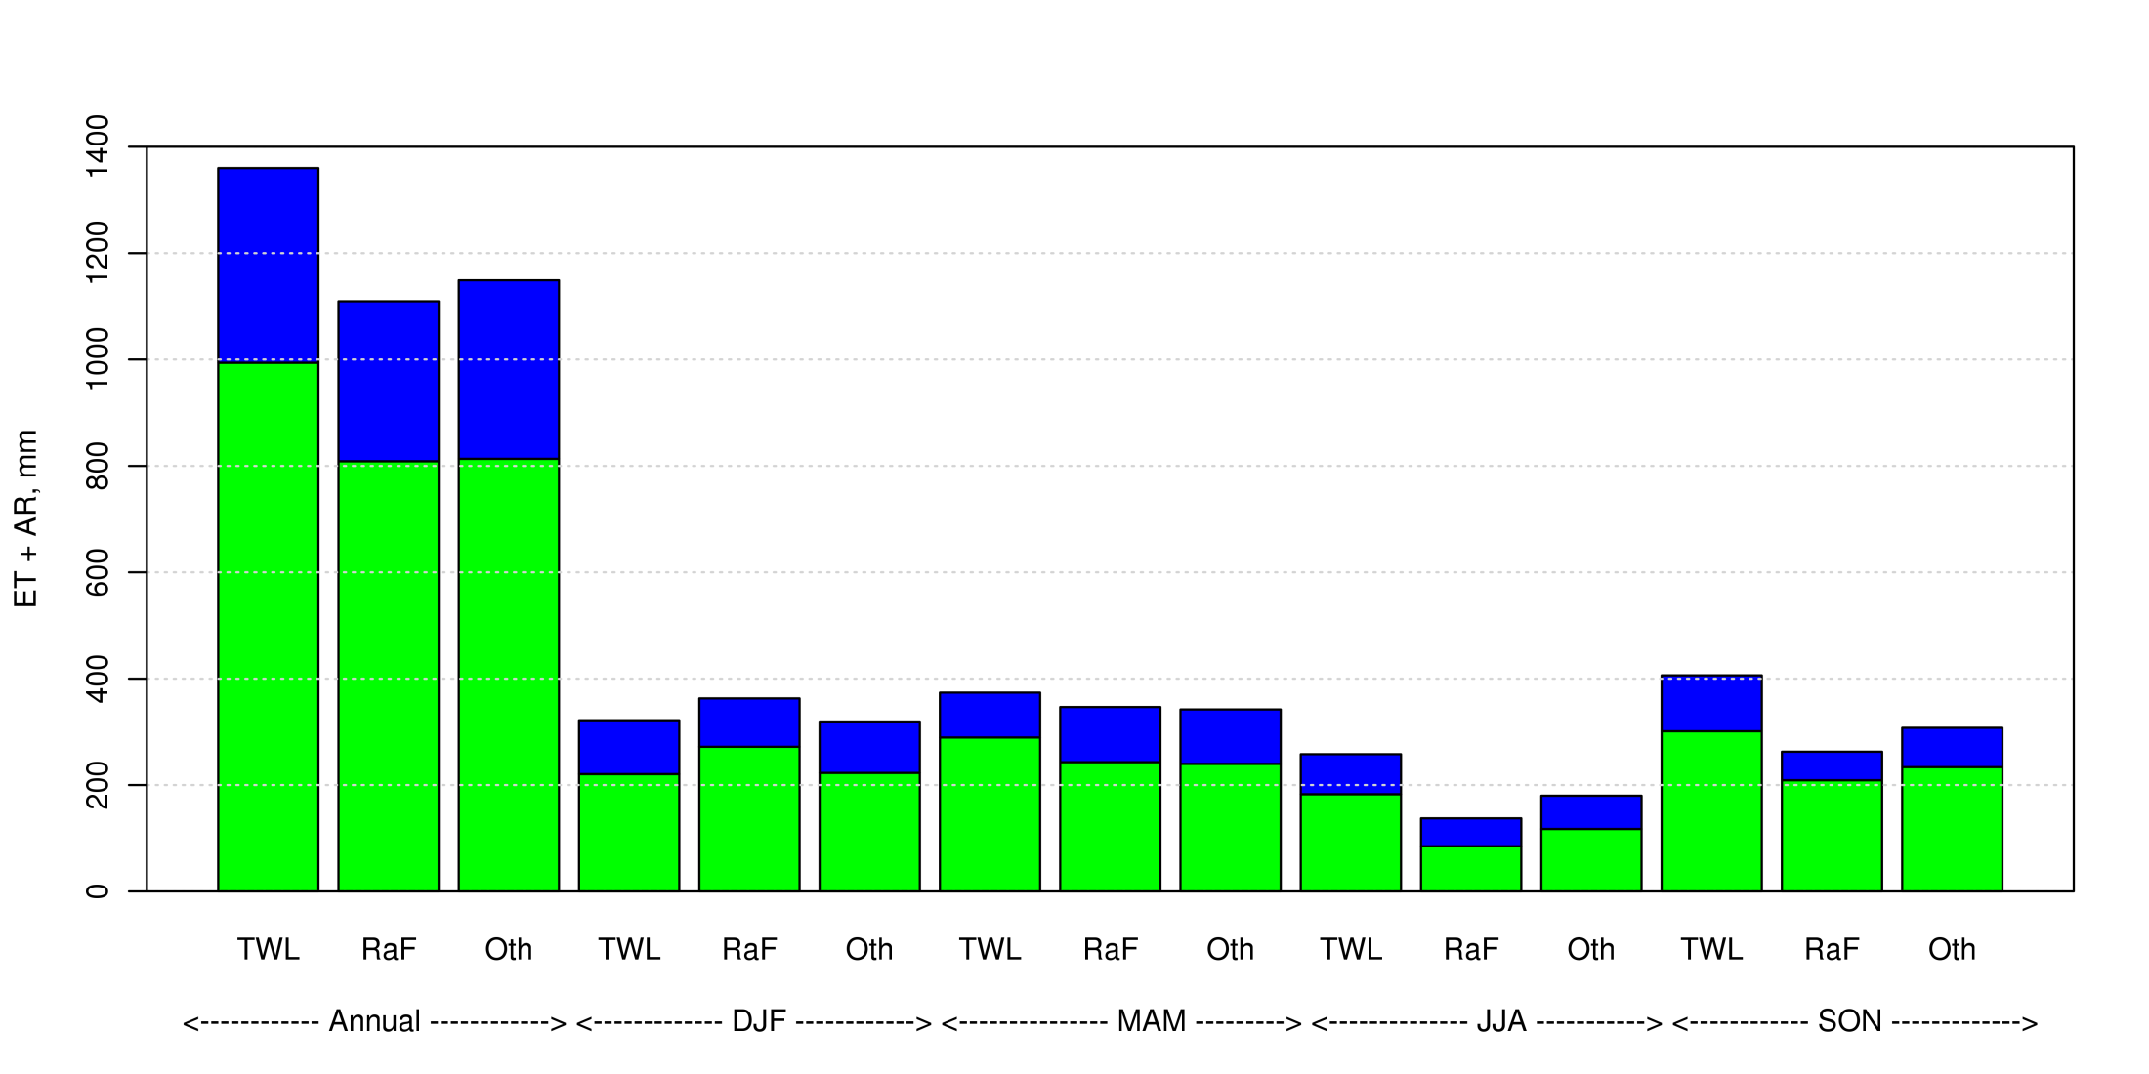
TWL – Tropical forests + Wetlands + Lakes, RaF – Rainfed agriculture areas, Oth – All regions excluding TWL

Slide 10
Trenberth, K. E., J. T. Fasullo, et al. (2009). "Earth's Global Energy Budget." Bulletin of the American Meteorological Society 90(3): 311-323.

