Slide 1
Landsat 8 – Thermal Bands
Frieda Fein
Heat Budget Meeting
July 3, 2013

Slide 2
What I’ve Been Working On
Comparing Landsat 8 Bands 10 and 11
Comparing ENVI SP3-calculated and manually-calculated radiance and brightness temperature data
Collecting data on cyan cloud pixels

Slide 3
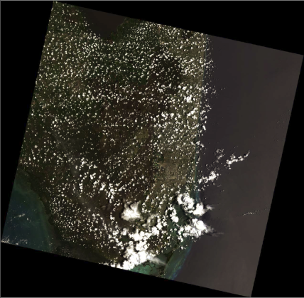
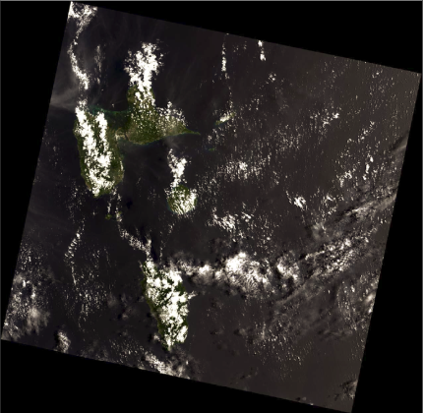
Images Used
Florida Dominica

Slide 4
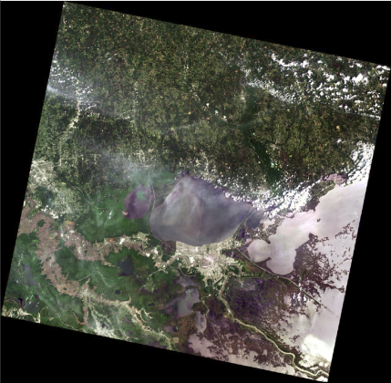
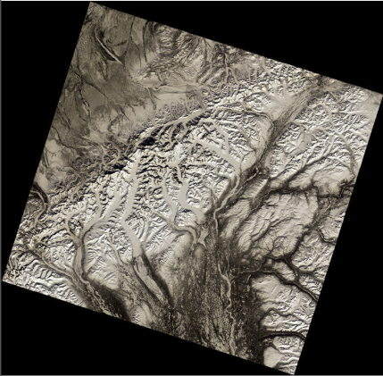
Images Used
Mississippi Alaska

Slide 5
Comparing Bands 10 and 11
Band 10 = 10.60-11.19μm and Band11 = 11.50-12.51μm
Calculated temperature values for both bands
Radiance: L_{λ} = M_{L}Q_{cal} + A_{L}
Temperature:
Created images of (Band 10 – Band 11)
T = |  | K₂
 | ln( | K₁ | +1)
 |  | L_{λ}

Slide 6
Band 10 and 11 Comparison - Results
Band 10 – Band 11, Mississippi:
Variation between bands loosely corresponds to land cover
Water: B10 ≈ B11
Clouds: B11 > B10
Difference increases as temp decreases
Lower altitude clouds tend to have smaller difference
Coastal Land: B10 > B11
Difference increases as temp increases
Mountains: B11 > B10
Difference increases as temp decreases
 | Mean | St Dev | Range
Dominica, B10-B11 | 1.58154 | 1.18862 | 32.3186
Florida, B10-B11 | 0.28009 | 1.26781 | 86.4368
Mississippi, B10-B11 | 1.14989 | 0.61606 | 14.885
Alaska, B10-B11 | -0.9243 | 0.57124 | 8.09055
Notes:
Note: land cover is proxy for temperature
Land cover (temp) trends consistent across images
BUT ROUGH (i.e. these trends tend to be present but correlation isn’t always super strong, varies within AND between images)

Slide 7
Band 10 and 11 Comparison - Results
Band 10 – Band 11, Mississippi
Notes:
KEY: black = most negative, white = most positve, water = close to zero
Size of difference between bands changes with temp
Temp corresponds pretty well to land cover – why I talk about in terms of land cover

Slide 8
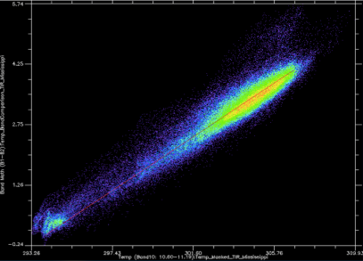
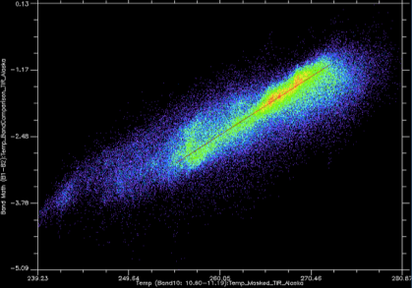
Band 10 and 11 Comparison - Trends
Physical causes of variation between B10 and B11
CO₂ atmospheric absorption starts to occur around 12.5µm
CO₂ absorption closer to B11 range so has greater distortion effect on that range
Effect due to altitude?
Effect due to temp?
ΔT
T(B10)
zero
zero
Notes:
When surface temp is hotter than air temp, more atmospheric absorption MEANING measured temp colder than true temp
When surface temp is colder than air temp, more atmospheric emission MEANING measured temp warmer than true temp
NOTE: haven’t checked atm temp (just assuming surf is warmer than air in southern images, vice versa in Alaska)
Mississippi scatter plot (over New Orleans) – Hotter temp = greater difference
Alaska scatter plot (near Mnt McKinley) – Colder temp = greater difference
Currently trying to calculate trend lines of T10 vs. ΔT to determine whether there is definable/consistent relationship (i.e. the effects of CO2) and how it varies based on land cover
i.e. Still working on isolating specific variables that could effect the difference
NOTE: lowland Alaska has less of a trend line, B10 ≈ B11 → surf temp between 272-276K , so close to air temp?
Low-lying clouds B10 ≈ B11 → absorption and emission offset by warm and cold atm layers?

Slide 9
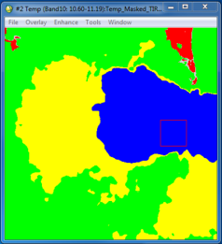
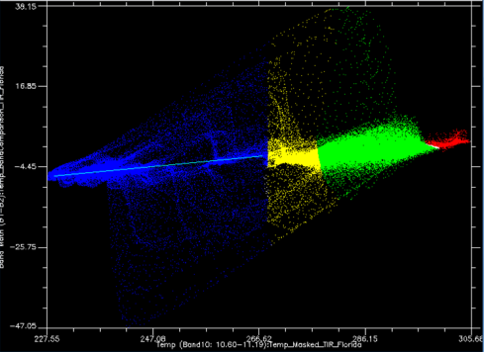
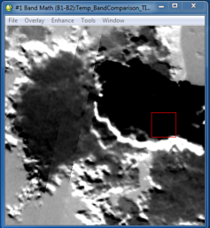
Band 10 and 11 Comparison - Trends
zero
ΔT
T(B10)

Slide 10
SP3 vs. Manual Calculations
ENVI SP3 can automatically calculate radiance and brightness temperature
Radiance: L_{λ} = M_{L}Q_{cal} + A_{L}
Temperature:
Compare to radiance and temperature data calculated using reflectance data in Band Math (Manual – SP3)
T = |  | K₂
 | ln( | K₁ | +1)
 |  | L_{λ}

Slide 11
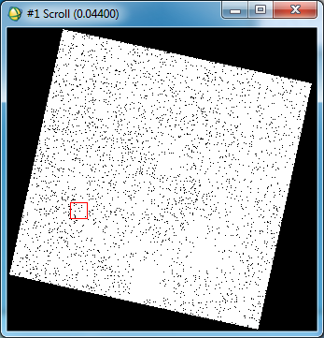
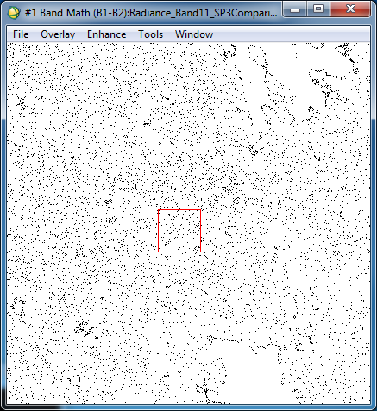
SP3 vs. Manual Calculations - Results
Radiance: (Manual – SP3), Band 11 Florida
Notes:
Mean difference between methods on the scale of 10⁻⁸
Black pixels = -9.5E-7
White pixels = 0
White pixels in clouds = -4.7E-7

Slide 12
SP3 vs. Manual Calculations - Results
Temperature: (Manual – SP3), Dominica Band 11
Average difference between 0.5K and 1.5K for Band 10
Average difference between 3.9K and 6.3K for Band 11
Notes:
NOTE: size of difference depends on land cover (i.e. temp)
White = greatest difference, black = smallest difference (all values positive)

Slide 13
SP3 vs. Manual Calculations - Results
Calculated emissivity for SP3-calculated and manually calculated data (ε = Radiance/ B_{λ}(T))
Emissivity appears to vary with temperature
Notes:
Alaska Emissivity, Band 10, from manually calculated temperature and radiance.
Example of emissivity variation with temperature
Higher emissivity corresponds to regions with lower temperatures = black
Lower emissivity corresponds to regions with higher temperatures = white
Emissivity appears to vary with land cover because temperature varies with land cover.
NOTE: emissivity doesn’t actually vary (i.e. entered into equation as 1), just appear to vary because of working backward in to calculate it (i.e. really, the error is in the output, temperature)

Slide 14
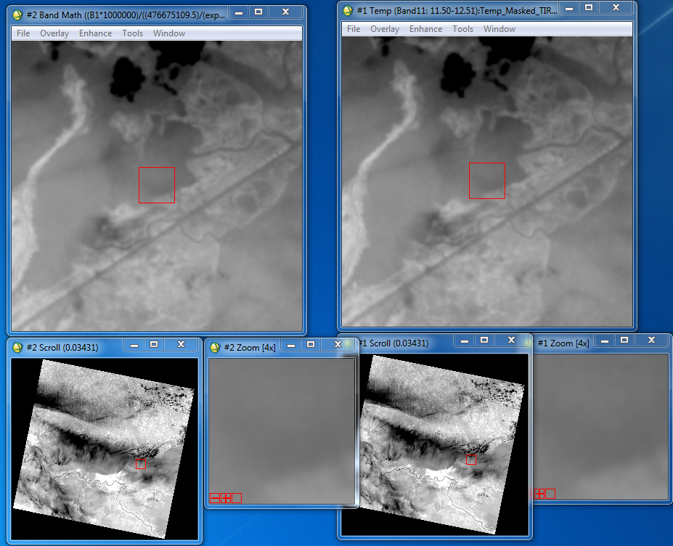
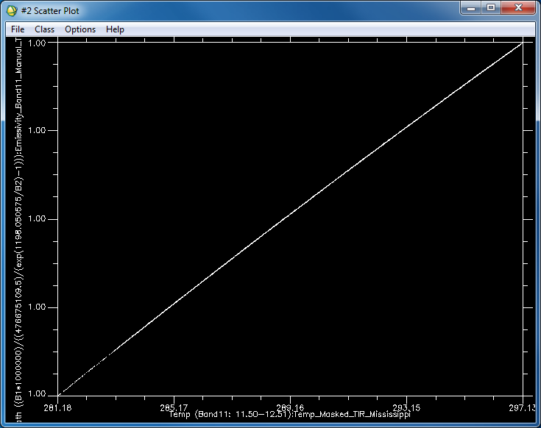
SP3 vs. Manual Calculations - Results
Strong trend between temperature and emissivity
Notes:
Images of emissivity based on manually calculated data (left), manually calculated temperature (right). Image windows used to produce 2D scatter plot (below). Both images of Mississippi, Band 11.
Scatter Plot: X-axis = manually calculated temperature; Y-axis = emissivity (based on manually calculated data)
These trends are image independent

Slide 15
SP3 vs. Manual Calculations - Results
Effective emissivity Ranges:
Emissivity varies with temperature. Presumably as a result of some rounding mechanism used by ENVI
Rounding mechanisms appear to differ between ENVI SP3 and ENVI Classic
Relationship between emissivity and temperature is definable (e.g. ε = (5.25114E-6)*T + 0.995721818)
 | Min | Max
Manual Band 10 | 0.996923 | 0.997367
SP3 Band 10 | 0.968621 | 1.017637
Manual Band 11 | 0.995353 | 0.998676
SP3 Band 11 | 1.010261 | 1.102395
Notes:
Equation for Band 10, manually-calculated data (most shallow slope but offset is pretty representative)
Conclusion:
Error introduced in conversion from radiance to temp
Size of error is temp dependent (i.e. varies with temperature)
Scene independent (i.e. one equation defines each method/band, works in all four images)

Slide 16
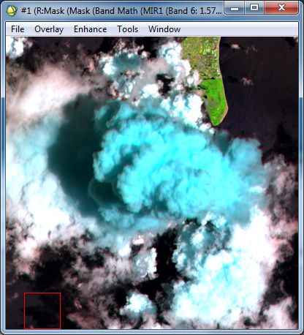
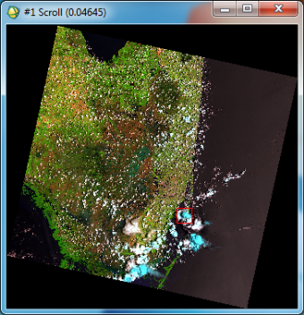
Cyan Clouds
654-RGB
Band 6 = 1.57-1.65μm, Band 5 = 0.85-0.88μm, Band 4 = 0.64-0.67μm
Notes:
Goal: spectrally characterize cyan cloud pixels
So far we’ve checked against ice index, temperature, albedo

Slide 17
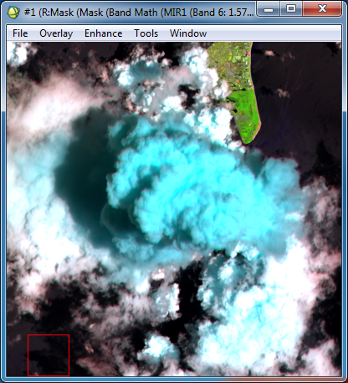
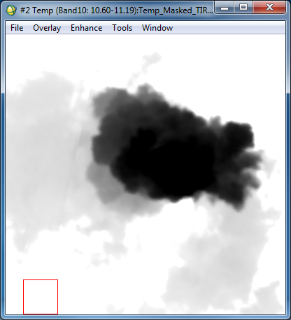
Cyan Clouds - Trends
Completely cyan clouds correspond to low temperature
Notes:
Temp image: Band 10, interactive stretching set with min at 235K and max at 280K
Note: cyan cracks do not have distinct temperature

Slide 18
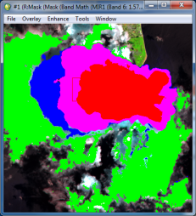
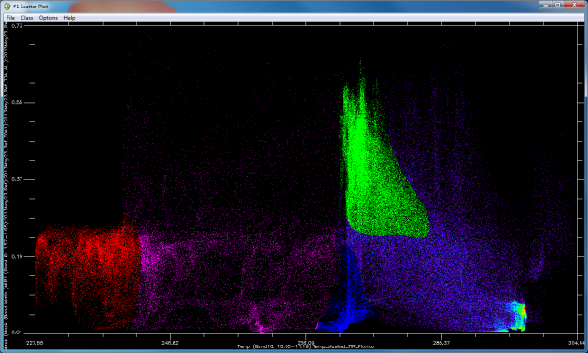
Cyan Clouds – Trends
Radiance (B6)
Temp (B10)
233K (-40ºC)
273K (0ºC)

Slide 19
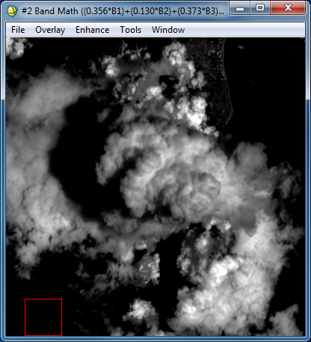
Cyan Clouds - Trends
Completely cyan clouds do not correspond to a specific albedo range
Notes:
Albedo image: Band 10, interactive stretching set with min at 0.2 and max at 0.9 (Using Liang method - Bands
Note: no cyan in absolute brightest regions of image

Slide 20
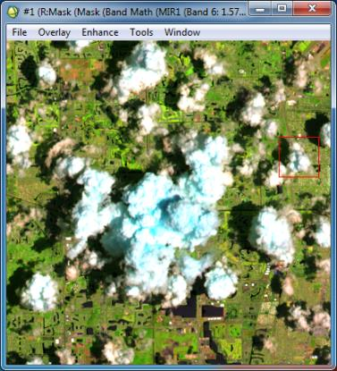
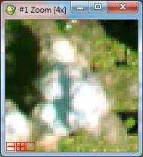
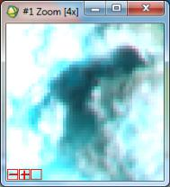
Cyan Clouds - Trends
Cyan cloud “borders” correspond to shaded regions or crevices on the on shaded side of clouds
Notes:
Note: Bottom Zoom Image not highlighted on big image (point to its region of origin)

Slide 21
Ending Thoughts
Variation between Bands 10 and 11 appears to depend on the absolute value of the difference between surface and air temperature
Still testing this
SP3 and manually calculated temperatures appear to differ based on an input-dependent rounding mechanism in ENVI
Cyan clouds appear because of ice particles. But also due to shadows? Particle size?

