Slide 1
Sensitivity of WRF microphysics to aerosol concentration
Azusa Takeishi

Slide 2
1. Introduction
1/15
Effect of aerosols is one of the most uncertain factors in climate
Direct effect/ Indirect effects/ Semi-direct effect
Aerosol – Deep convection
Even though the areal coverage of deep convection is small, its vertical motion is a part of local-/regional-/large-scale motion
It is important to understand the effect of aerosols on deep convective clouds and assess its climatic effects

Slide 3
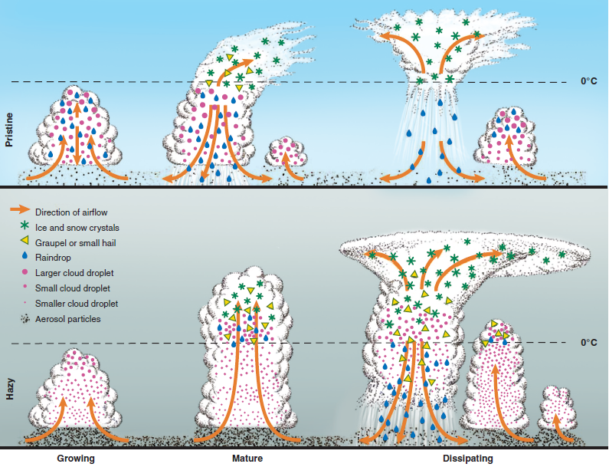
1. Introduction How does deep convection change with aerosol Loading?
2/15
Rosenfeld et al. 2008
Cloud-aerosol interaction

Slide 4
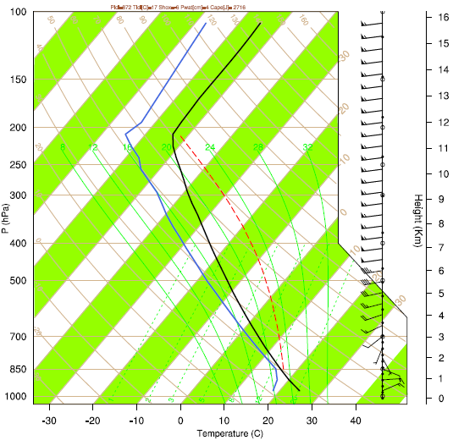
2. Methods
3/15
Weather Research and Forecasting (WRF) model
Idealized simulation of quarter-circlular shear supercell
Resolution: 2km (hori.), 500m (vert.)
Maximum heating (3K) in the lower troposphere at the center of the domain (200km*200km) -> trigger convection
3 hours of simulation with open boundary conditions
Left:
Skew-T log-P diagram of initial profile
Right: Hodograph of initial wind profile

Slide 5
2. methods
4/15
Microphysics schemes: 2-moment schemes were chosen
Morrison scheme (Morrison et al, 2005)
6 categories of hydrometeors
(water vapor, cloud, rain, ice, snow,
graupel/hail)
Fixed number concentration of cloud droplets (default = 250 ${cm}^{−3}$)
↓
multiply the number of cloud droplets by 0.2, 0.5, 1 (control), 2, 3, 4, 5, and 6
Milbrandt-Yau scheme (Milbrandt and Yau, 2009)
7 categories of hydrometeors
(water vapor, cloud, rain, ice, snow,
graupel, hail)
Calculate the number of CCN using w, P, and T
↓
multiply the number of CCN by 0.2, 0.5, 1 (control), 2, 3, 4, 5, and 6
Simulating 2 pristine cases + 1 control run + 5 polluted cases
- How does the precipitation change? Why?

Slide 6
3. Results [Morrison scheme]
5/15
Accumulated precipitation slightly decreases with increased aerosols
But this decrease is quite small: ~5%
Moreover, this decreasing trend disappears when the horizontal resolution is set to 1km, when the heating is changed to 2K or 4K, and with graupel

Slide 7
3. Results [morrison scheme]
6/15
Downdraft shows this decrease in precipitation intensity
Updraft does not
No interaction between downdraft and updraft
No robust aerosol effect found in the simulations with Morrison scheme

Slide 8
3. Results [Milbrandt scheme]
7/15
Drastic decrease in accumulated precipitation
Almost 80% decrease in precipitation, when we compare the most pristine case and the most polluted case
Robust feature, even when the horizontal resolution or the perturbation is modified (2K or 4K)

Slide 9
3. Results [Milbrandt scheme]
8/15
Both downdraft and updraft show the invigoration in the storm system
Almost symmetric change implies the interaction between downdrafts and updrafts
Robust aerosol effect found in the simulations with Milbrandt-Yau scheme
But why?

Slide 10
Which hydrometeor contributes?
9/15
Decrease in precipitation
RAIN
ICE
SNOW
GRAUPEL
HAIL
Melt
CLOUD
Stop melting of
(i) Hail
(ii) Hail and graupel
(iii) Hail, graupel, and snow
and see how frozen precipitation changes.

Slide 11
frozen precipitation
10/15
-> Decrease in graupel is the major reason for the decrease in total precipitation

Slide 12
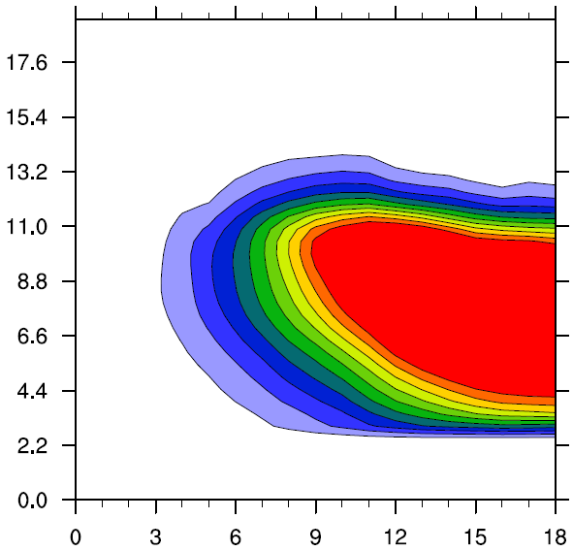
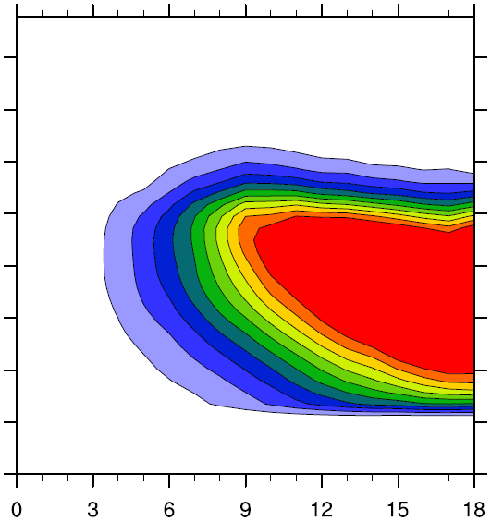
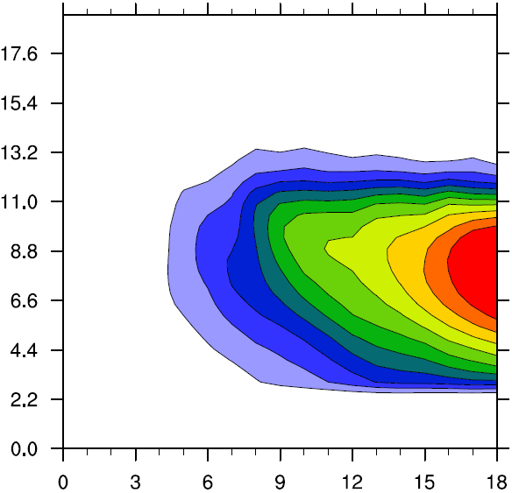
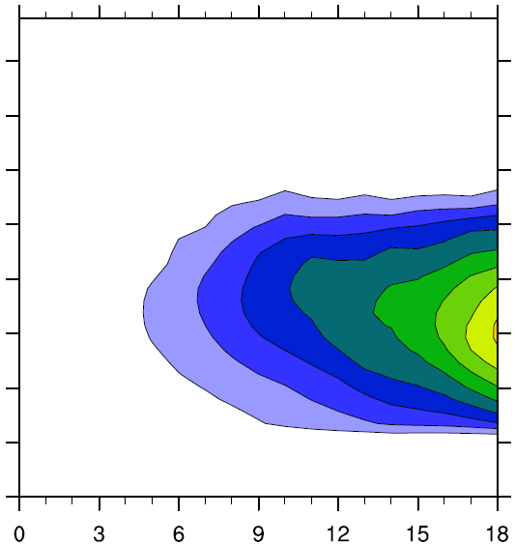
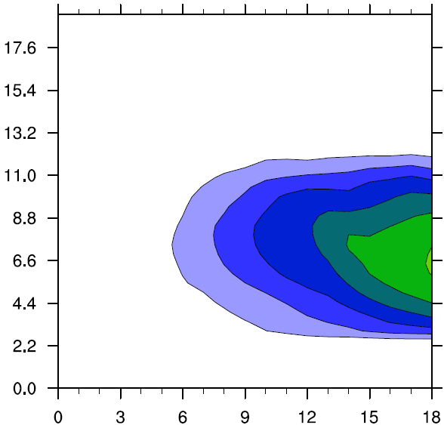
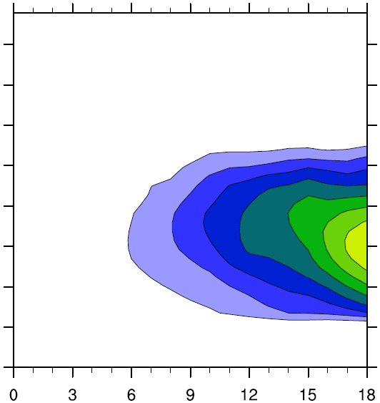
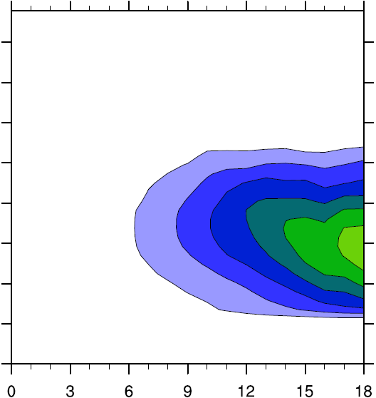
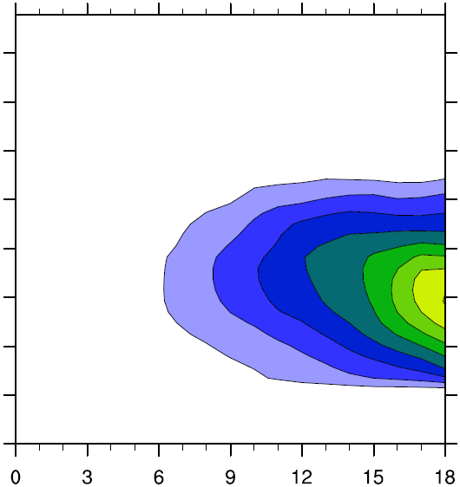
Graupel
11/15
Domain-average graupel mixing ratio
CCN=0.2*control
CCN=0.5*control
CCN=control
CCN=2*control
CCN=3*control
CCN=4*control
CCN=5*control
CCN=6*control
[g/kg]

Slide 13
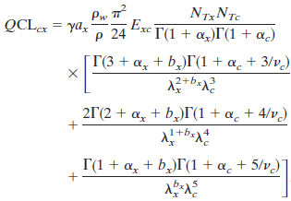
Why does graupel decrease?
12/15
Graupel forms when snow collects cloud droplets (riming)
Only when riming rate > deposition rate
Riming rate of snow is dependent on
(i) Total number of snow
(ii) Total number of cloud droplets
(iii) Size spectrum of snow
(iv) Size spectrum of cloud droplets
In pristine cases, cloud droplets are larger, so
riming rate > deposition rate
-> production of graupel -> fast/efficient precipitation
In polluted cases, cloud droplets are small, so
deposition rate > riming rate
-> production of snow -> slow/inefficient precipitation

Slide 14
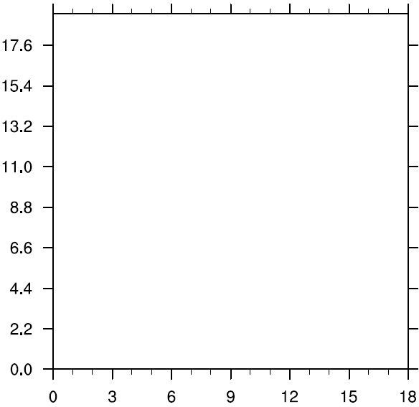
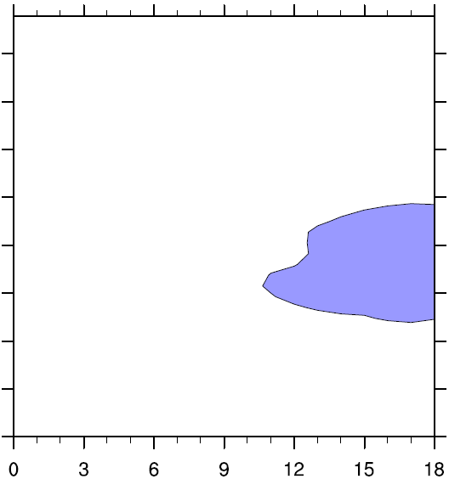
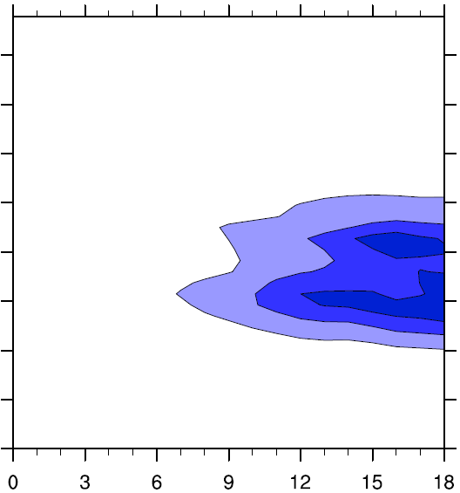
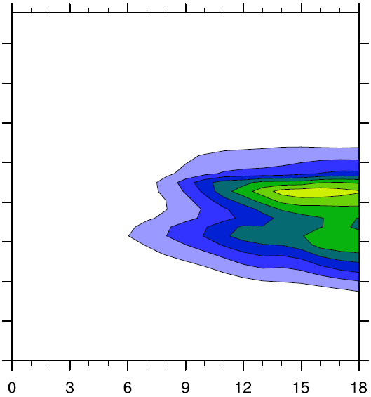
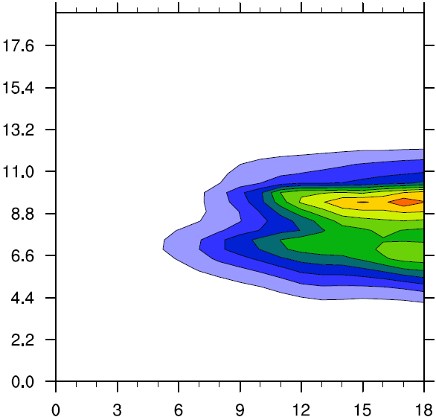
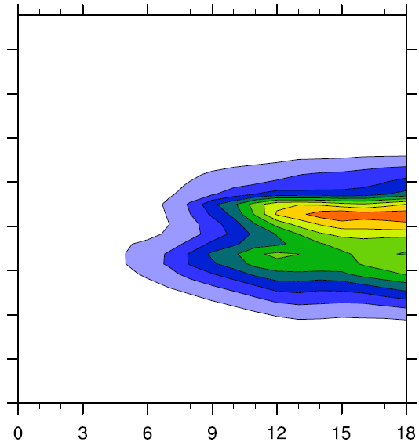
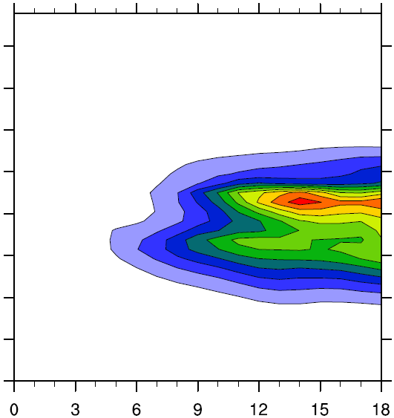
Snow
13/15
Domain-average snow mixing ratio
CCN=0.2*control
CCN=0.5*control
CCN=control
CCN=2*control
CCN=3*control
CCN=4*control
CCN=5*control
CCN=6*control
[g/kg]

Slide 15
4. Conclusion
14/15
Interaction between aerosols and deep convection is still not well understood
Simulations with Morrison scheme showed a low sensitivity to the aerosol concentration (4.9% reduction in precipitation) and this change is not robust
Simulations with Milbrandt scheme showed a high sensitivity to the aerosol concentration (79% reduction in precipitation) and this decrease is robust
Realistic simulations are necessary: types of aerosols, aerosol concentration, ideally 7 hydrometeors, inclusion of all processes, etc.

Slide 16
5. Future Work
15/15
Thompson scheme
Change humidity profile
Add radiation
Constrain simulations with observational data
Use of WRF-Chem

