Slide 1
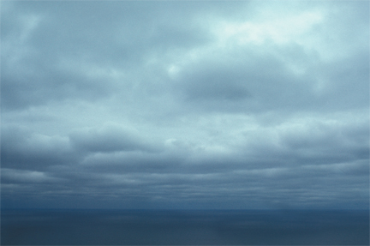
Influence of Clouds on Surface Heat Fluxes in an Energy Deficient Regime
Dea Doklestic
G&G 570 Class Project
Heat Budget Group Presentation, June 16, 2011

Slide 2
Questions
How do clouds influence surface heat budget?
How are turbulent heat fluxes influenced during overcast conditions?
Is latent heat flux mainly controlled by RH or plant transpiration?
How is longwave radiation influenced by clouds

Slide 3
Surface Heat Budget
LW ↓
SW
H LE
LW ↑
G
Rnet = S(1 – a) + LW ↓ - LW ↑
Rnet – G = H + LE

Slide 4
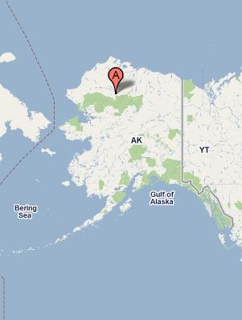
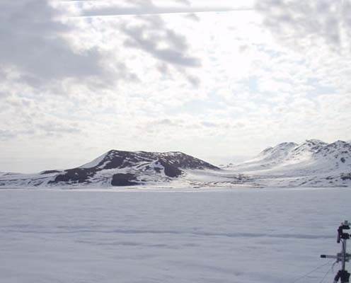
Region of Interest
Ivotuk, Alaska
Flux Tower equipped with pyranometers to measure incoming and outgoing SW radiation and infrared thermometers to measure outgoing and incoming LW radiation
Turbulent fluxes estimated using the eddy covariance method (sonic anemometer)
Location: 68N, 155W
Available data: 2004 - 2006

Slide 5
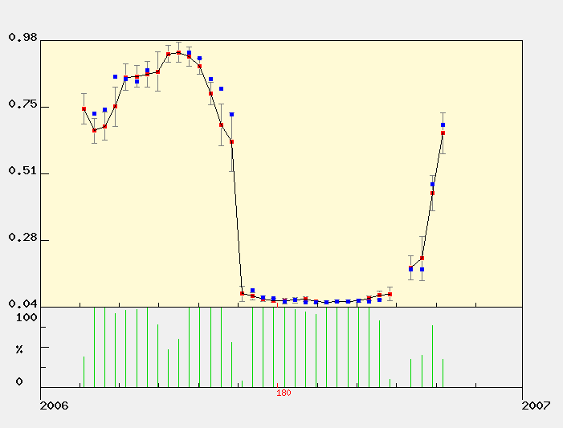
Approach
2 different states
Snow on the ground (DOY 132 – 145)
No snow on the ground (DOY 195 – 208)
Albedo (Visual)
Image obtained from: http://daac.ornl.gov

Slide 6
1. Penman-Monteith Equation for evaporation from a wet surface (Potential Evaporation)
Evaporation from a wet surface given the available energy and vapor pressure deficit
Assumed to be maximum possible evaporation for the given available energy. (Water supply not limited)

Slide 7
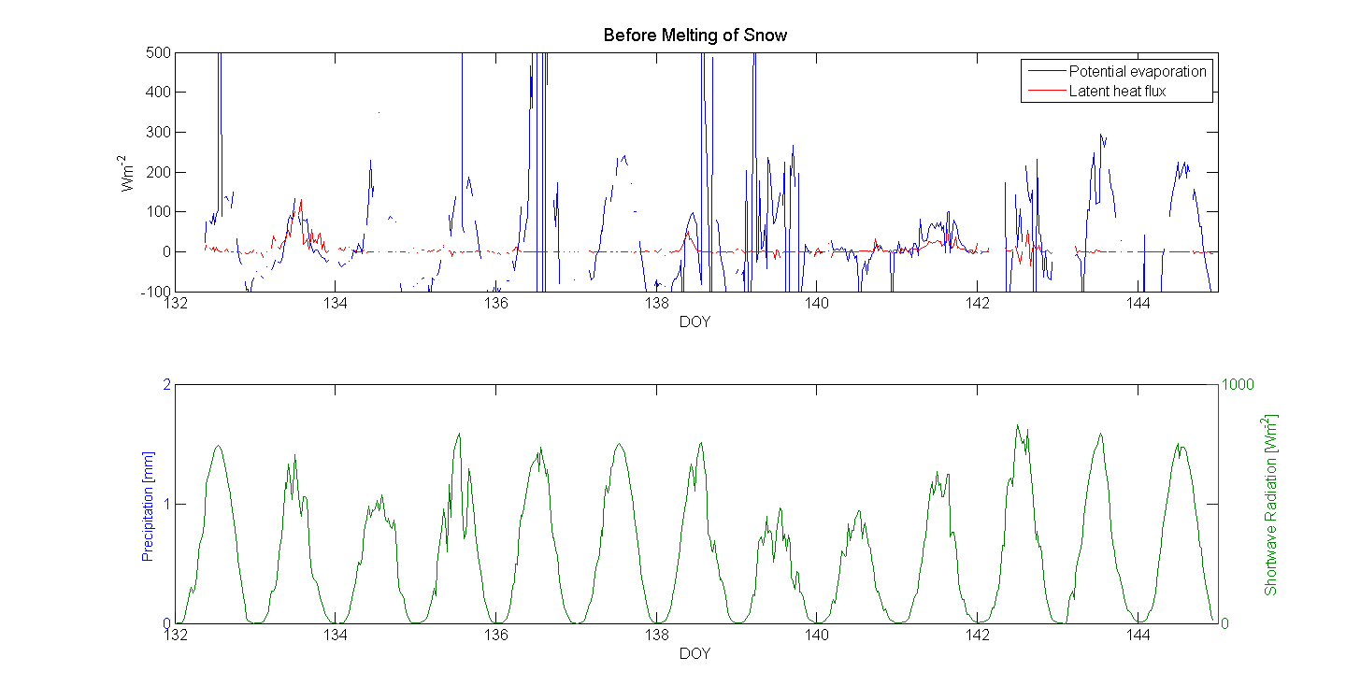
1. PE and Latent Heat Flux Before melting of snow

Slide 8
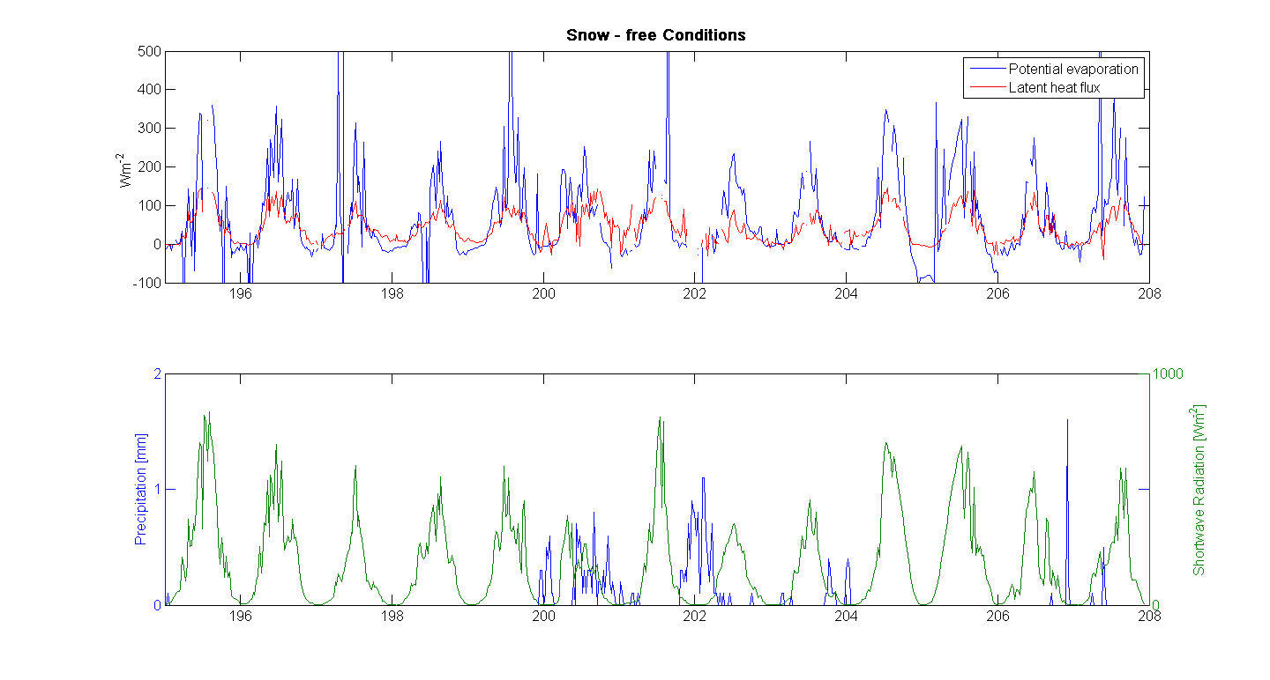
PE and Latent heat Flux Snow – free conditions

Slide 9
PE and Latent Heat Flux Conclusions
Spring
Summer
When the ground is still covered with snow, LH is zero
Different from modeled PE
PE over snow shows a diurnal cycle which is completely absent in measured data.
Latent heat flux exhibits a diurnal cycle
Maximum occurs during midday, minimum over night
PE grossly overestimates latent heat flux
Cloudiness does not seem to influence LH much

Slide 10
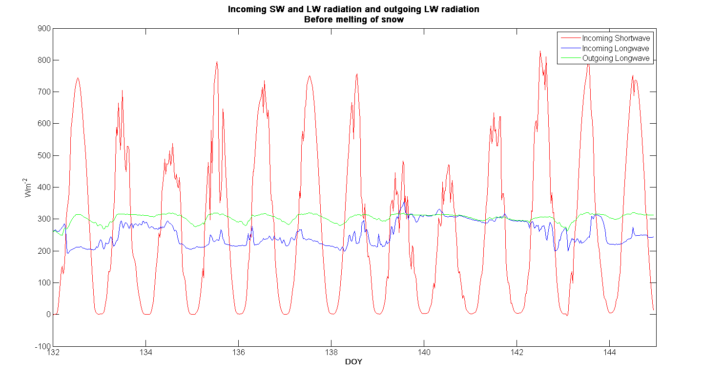
2. Influence of Clouds on Longwave Radiation Before melting of snow

Slide 11
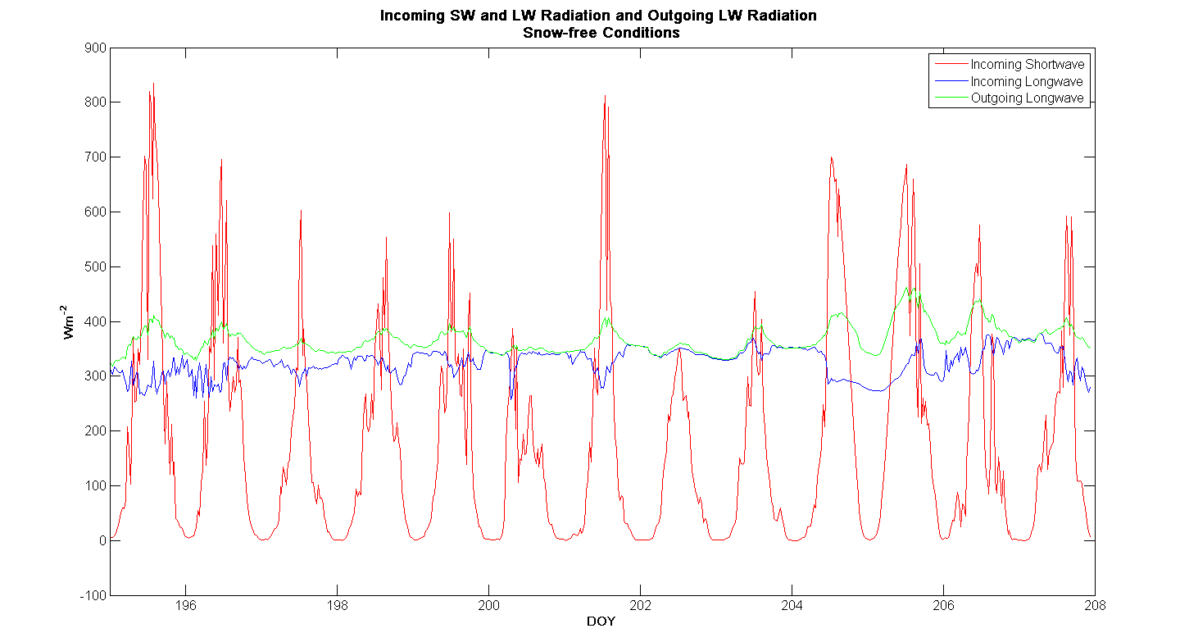
2. Influence of Clouds on Longwave Radiation Snow-free conditions

Slide 12
2. Clouds and Longwave Radiation Conclusions
Spring
Summer
On clear days – OLR exhibits a diurnal cycle.
Maximum radiation emitted during daytime, minimum during night
On cloudy days – diurnal cycle in OLR vanishes
Incoming LW radiation higher on cloudy days – both in spring and summer
Shows no diurnal variations
On clear days – OLR exhibits a diurnal cycle.
During summer, even on cloudy days there is some diurnal variation in OLR
Likely due to more SW radiation being absorbed at the ground because of a much lower albedo. )That drives a diurnal cycle in surface temperature)

Slide 13
Do the clouds inhibit snow melting or do they accelerate it?
During winter conditions when SW radiation is zero, the presence of clouds will increase RNET
In spring – solar radiation gets higher – clouds have a double effect:
Decrease incoming shortwave radiation
Decrease outgoing longwave radiation & increase incoming LW
These two effects work in opposite directions, so which one is dominant?

Slide 14
Approach
Model incoming SW radiation:
Incoming LW – assumed to be constant throughout the day. Set to 200Wm⁻²
Outgoing LW – has a diurnal cycle which is modeled as:
i goes from 1 – 48 and corresponds to a 30-minute period
This equation gives a minimum OLW value of 250 Wm⁻² and a maximum value of 320 Wm⁻² at noon

Slide 15
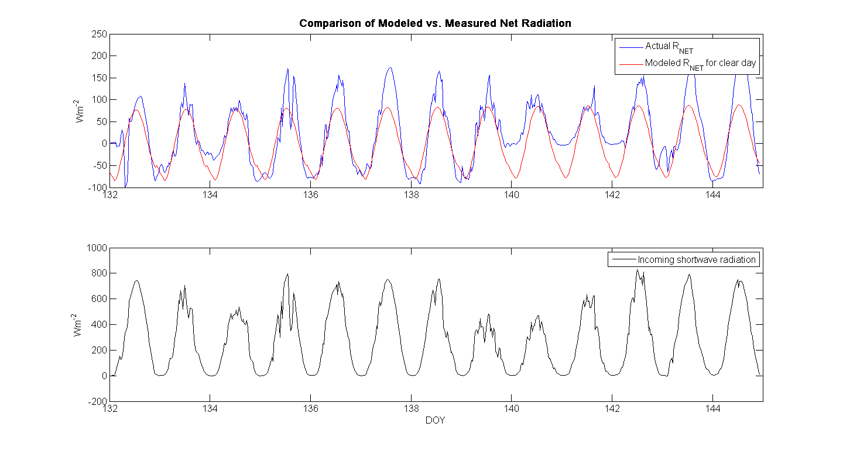
Results Comparison of Modeled vs. Measured Net Radiation

Slide 16
Influence of clouds on melting of snow Conclusions
Time period DOY 132 – 145
Modeled perfectly clear days
Transmisivity 0.9
Albedo 0.75
Net radiation modeled this way was lower than observed net radiation on cloudy days
In this particular case, cloudiness seems to accelerate melting of snow

