Slide 1
The ImpactS of urbanization on surface albedo in the Yangtze River Delta Introduction
Mélanie Bourré
06/02/2011

Slide 2
Motivation
Since the 20th century, there has been a rapid urbanization of the world population.
United Nation prediction (2006) : 60% of the world population will live in cities by 2030.
In these newly urbanized area, we observe a local climate change : « Heat Island Effect ».
Although it affects many people, the relationship between urbanization and local climate change is not well understood.
However, the role of surface properties on climate has been recognized by many recent studies.
Urbanization → Surface albedo change → Climate change.

Slide 3
Methodology
Remote sensing data.
Processed and analyzed by ENVI software.
Selection of two Landsat TM images
One from the late 80s, one from nowadays
Urbanization study
- Classification of the two images
- Calculation of the urbanization rate
Albedo calculation
- Atmospheric correction
- Albedo calculation using Liang’s formula
Analysis
Correlation of albedo change with urbanization

Slide 4
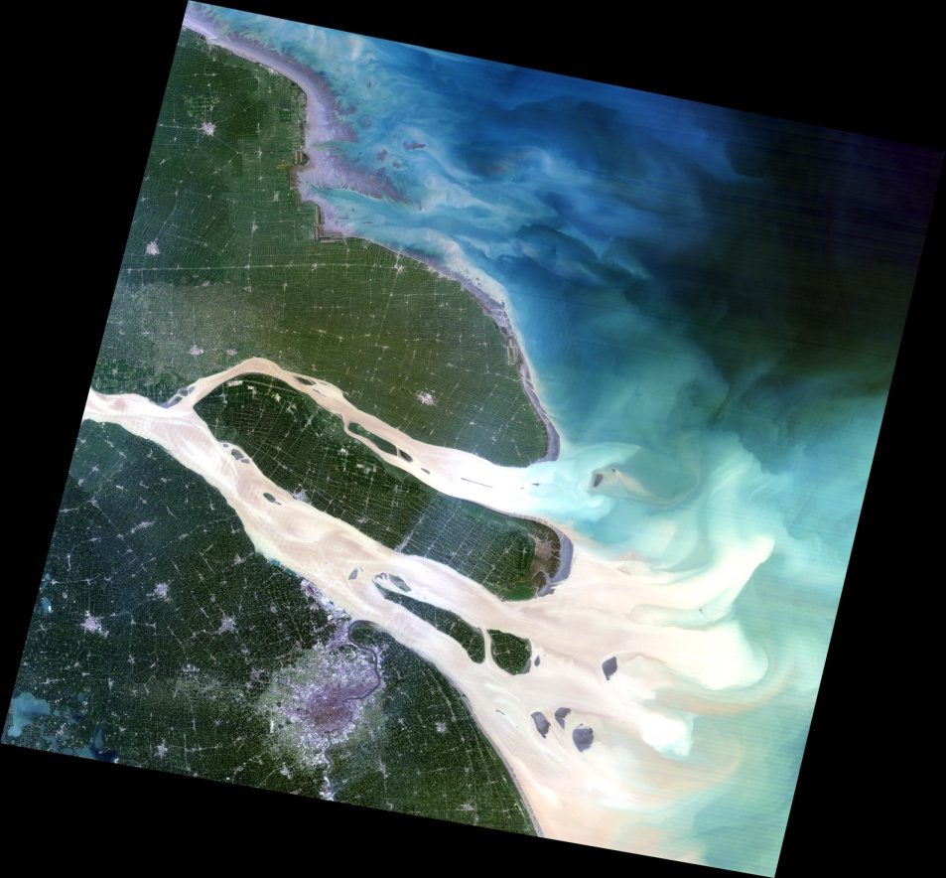
Study area
Mouth of Yangtze River Delta in China
Yangtze River Delta :
- One of the most industrialized and urbanized region of China.
- Highest population density of China.
Coordinates :
Long : 120°39’E Lat : 32 °40’N
Path : 118 Row : 38
Area : ~35000 km²
www.landsat.org Acquisition date : 08/11/1989

Slide 5
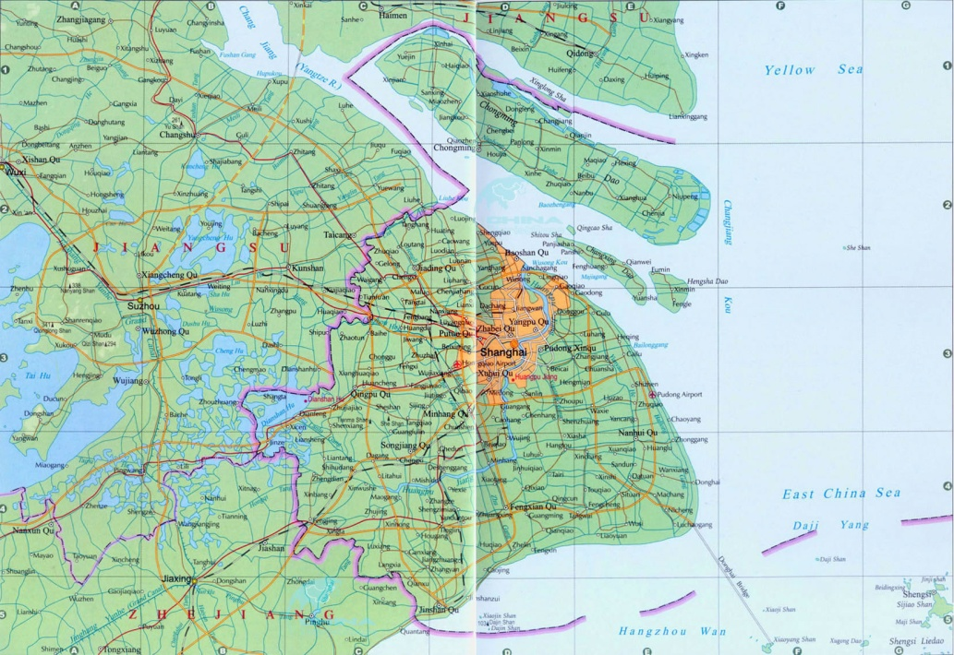
Source : www.chinatouristmaps.com
Two provinces : - SE Jiangsu
- NE Shanghai

Slide 6
Environment
Human activities
Geology
Alluvial plain
Elevation : 4m
Hydrology
Delta
Numerous rivers and lakes
Maze of intersecting canals
Climate
Humid subtropical climate
Vegetation
Subtropical broad-leaf evergreen.
Primary sector
Agriculture
Fisheries
Aquaculture
Secondary sector
Traditional center of textile industry
Industrial base advancing new technology
Import/Export
Tertiary sector
Commerce and finance
Transportation

Slide 7
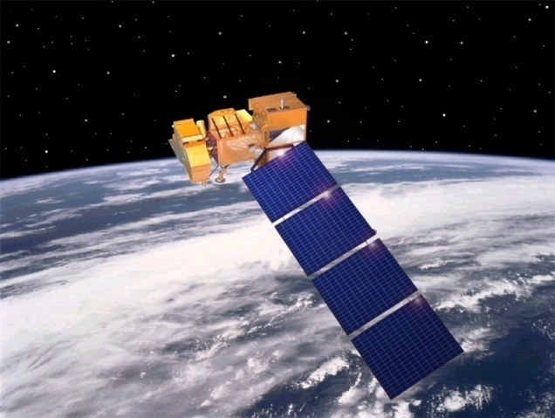
Satellite Images
Source : Global Land Cover Facility
www.landcover.org
Source : www.landsat.gsfc.nasa.gov/images/media.html
Author | NASA Landsat Program | NASA Landsat program
Publication Date | 05/16/2001 | May 2007
Collection Name | Landsat 5 TM scene | Landsat 7 ETM+ scene SLC-off Gap-filled products
Image Name | ID 201-985 | ID 217-852
Processing Level | Ortho, GLS 1990 | Ortho, GLS2005
Publisher | USGS | USGS
Publisher Location | Sioux Falls | Sioux Falls
Product Coverage Date | 08/11/1989 | 08/15/2005

Slide 8
Image preprocessing
Picture cut
Pictures of different sizes
Band issues on the left and right sides of the 2005 image
→ Cut the pictures with ENVI software
Geometric and radiometric correction
Performed by USGS
Atmospheric correction
No clouds or hazes → No atmospheric correction needed
Image enhancement
Automatic linear contrast stretching of 2% by ENVI

Slide 9
Visual interpretation
Color infrared composite
Color displayed | Band | Spectrum region
Red | 4 | NIR
Green | 3 | Visible Red
Blue | 2 | Visible Green
Area type | Urban area | Vegetation | Water
Sample

Slide 10
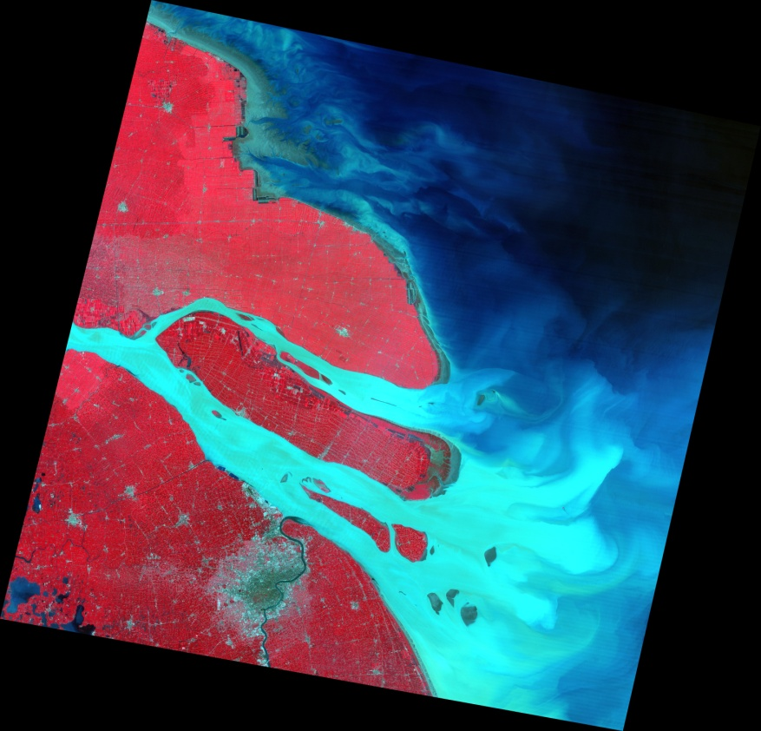
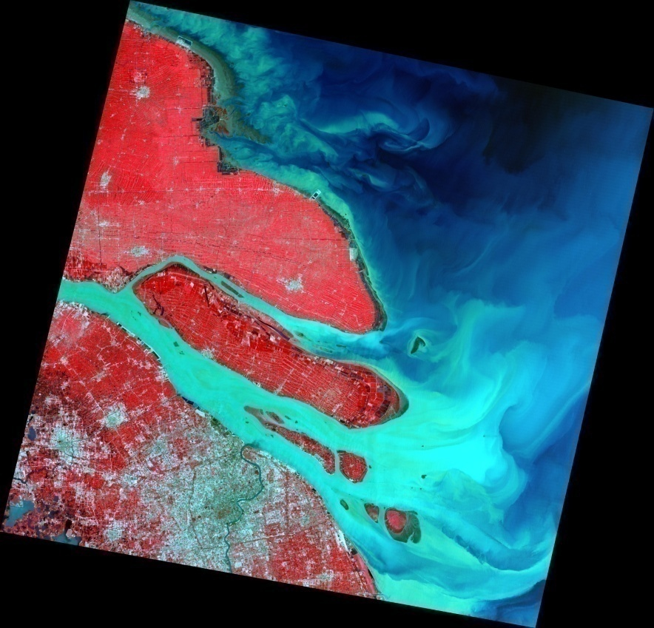
08/11/1989
08/15/2005
Yangtze River Delta

Slide 11
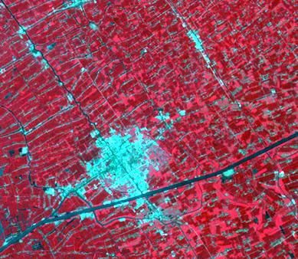
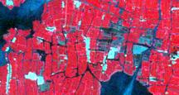
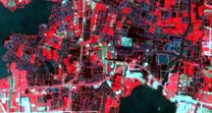
08/11/1989
08/15/2005
Taicang
Aquaculture

Slide 12
Classification
Methodology :
Classification processed on the Digital Numbers within the 6 non thermal bands.
Unsupervised classification
ISODATA algorithm ENVI Software
Identification with ground reference data
Choice and definition of classes
Supervised classification
Maximum Likelihood Classifier ENVI Software.
Accuracy assessment

Slide 13
Unsupervised classification
Aim : Evaluate the separability between classes and so guide the supervised classification.
Principle: - The software groups together pixels of similar spectral pattern.
ISODATA algorithm
- The analyst identifies the clusters.
Chosen parameters :
Number of classes : Between 5 and 10
Number of iterations : 10
Change Threshold : 5%

Slide 14
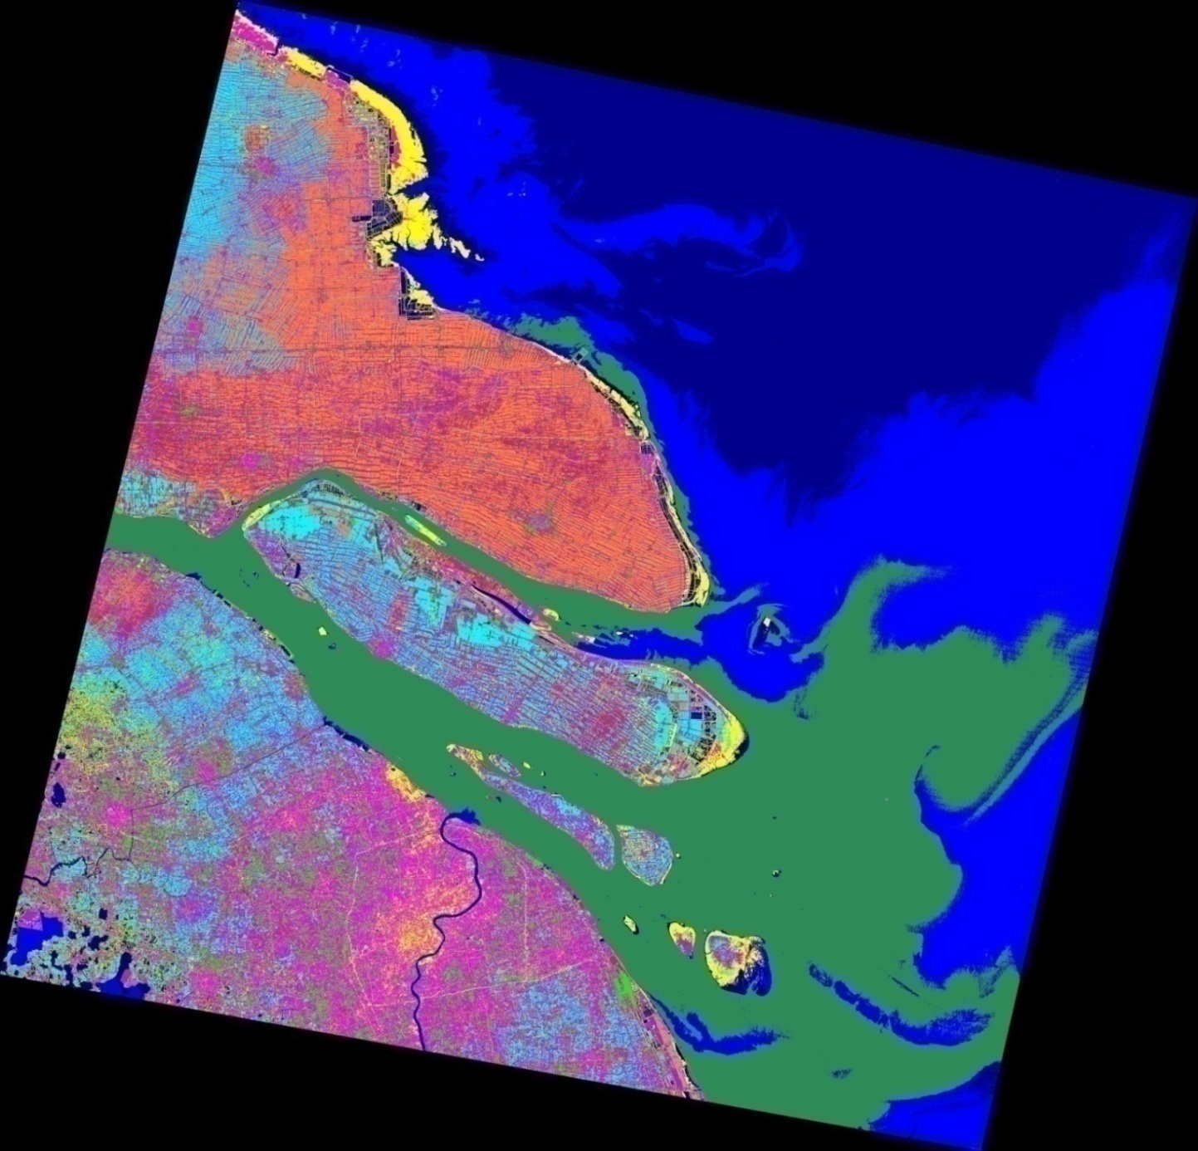
08/15/2005 Unsupervised classified image
Ground reference data
Google Earth 08/23/2005
And panorama pictures
Atlas of China, Du Xiurong, 2007
Spectral patterns
Color infrared composite

Slide 15
Identification
Remark : identification = most representative land cover type found within the class.
Misclassified pixels within each class.
Class Number | Class color | Area % | Identification
1 | Blue 3 | 13.199 | Water
2 | Blue 2 | 13.693 | Water
3 | Seamarine | 14.715 | Water
4 | Yellow | 3.502 | Inter Tidal + Urban Land
5 | Cyan | 4.811 | Agricultural Land : Irrigated Paddy Field
6 | Purple | 4.815 | Several land cover types
7 | Maroon | 4.709 | Several land cover types
8 | Green | 1.728 | Urban Land : High Density
9 | Magenta | 3.917 | Urban Land : Medium Density
10 | Coral | 5.787 | Agricultural Land : Dry Farmland

Slide 16
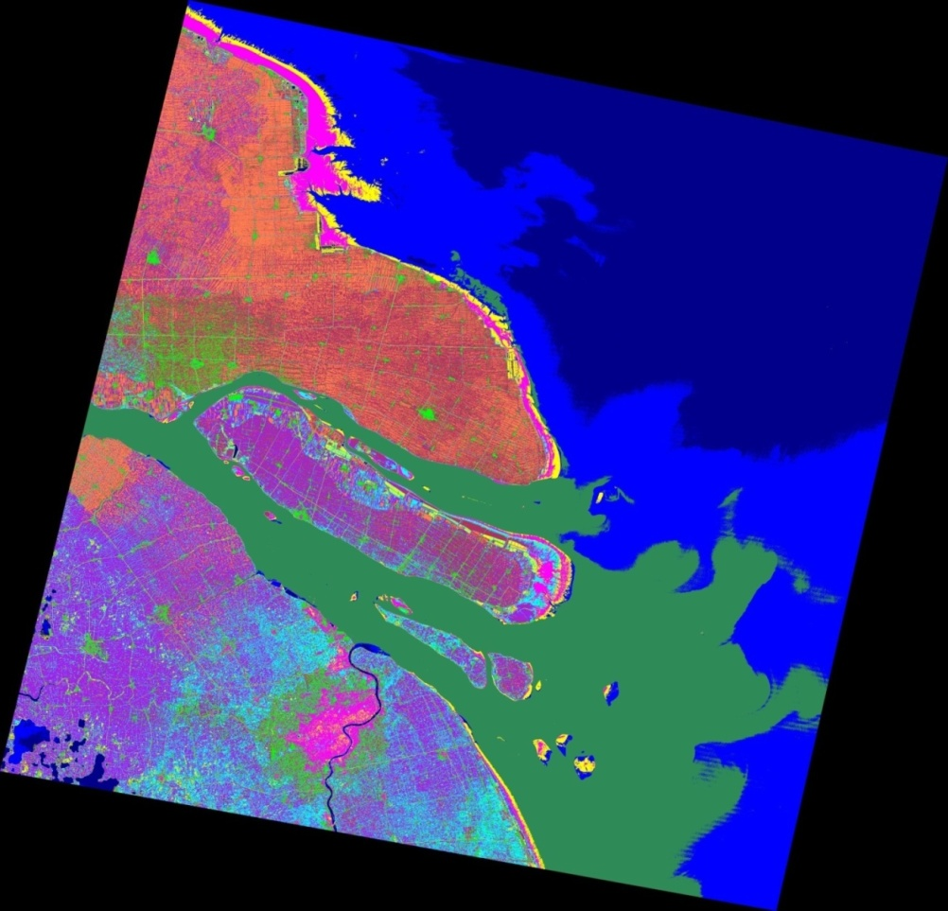
08/11/1989 Unsupervised classified image
Problem : No valuable ground surface data
Spectral patterns
Color infrared composite

Slide 17
Identification
Class Number | Class color | Area % | Identification
1 | Blue 3 | 15.319 | Water
2 | Blue 2 | 12.367 | Water
3 | Seamarine | 13.523 | Water
4 | Yellow | 1.495 | Inter Tidal
5 | Cyan | 3.898 | Several land cover types
6 | Purple | 7.775 | Agricultural Land : Irrigated Paddy Field
7 | Maroon | 6.738 | Several land cover types
8 | Green | 2.54 | Urban Land : High Density
9 | Magenta | 2.016 | Urban Land : Medium Density + Inter Tidal
10 | Coral | 5.205 | Agricultural Land : Dry Farmland

Slide 18
Supervised classification
Principle : - The analyst defines the classes and their numerical descriptors.
- The software labels each pixel with the class it belongs to.
Maximum Likelihood Classifier

Slide 19
Choice of classes
USGS « LU/ LC Classification System for Use with Remotely Sensed Data »
Landsat images → Level I Classification
1) Urban or Built-up Land 2) Agricultural Land 3) Rangeland 4)Forest Land
5) Water 6) Wetland 7)Barren Land 8)Tundra 9)Perennial Snow or Ice
Applied to our area → Urban Land, Agricultural Land, Rangeland ,Forest Land, Water and Barren Land.
Unsupervised classification : - Inter Tidal as a class
- No classes for Range, Forest and Barren Lands → Problem to classify

Slide 20
Training samples
For each class, Training samples = representative set of sites.
Compile a numerical interpretation key, that describe the spectral pattern of the class.
Class | Image | Samples
Urban Land | Color infrared composite | Bright blue, mixed zone
Agricultural Land | Unsupervised classified image | At least the 2 agricultural classes
Range Land | Visible | Known golf and garden
Forest Land | Visible | Known parks and forests
Water | Unsupervised classified image | At least the 4 water classes
Barren Land | Color infrared composite | Yellow
Inter Tidal | Unsupervised classified image | Yellow

Slide 21
Future work
The coming week
Training samples
Maximum likelihood classification
Later
Accuracy assesment
Urbanization rate
2nd part of the project : Albedo calculation

Slide 22
Thank you!

