Slide 1
A detailed look at the MOD16 ET algorithm
Natalie Schultz
Heat budget group meeting
7/11/13

Slide 2
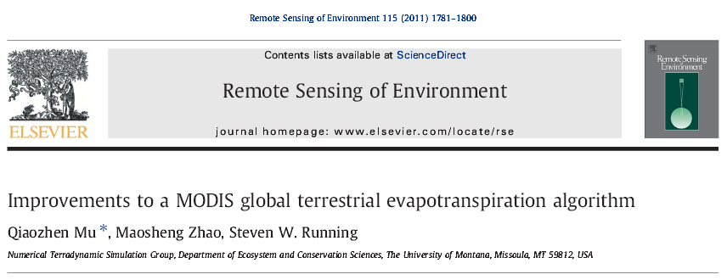
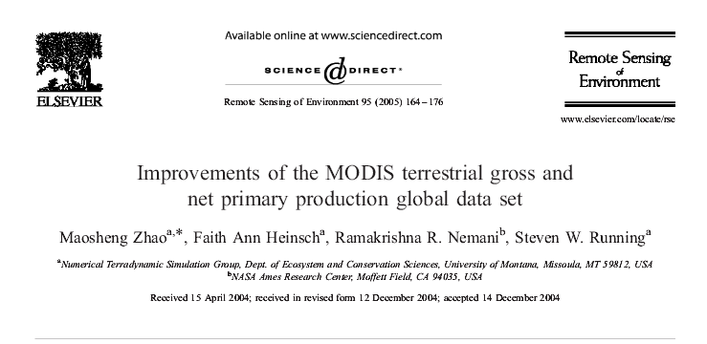
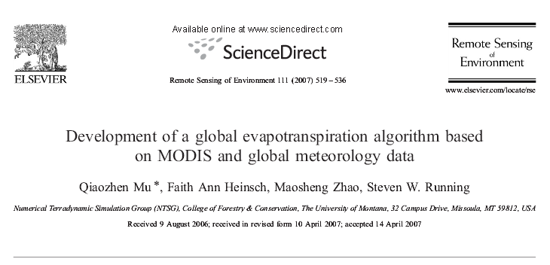
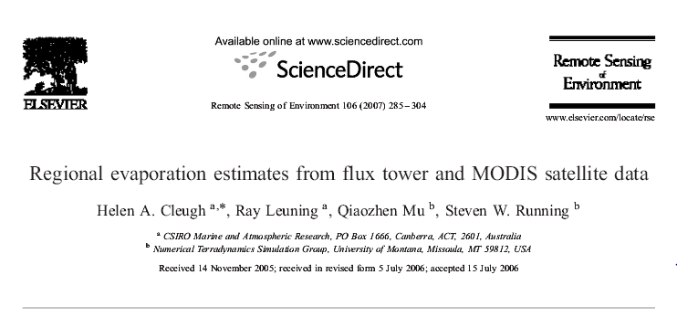
Notes:
Review of the algorithm developed to create the global ET product.
ET is an important component of the surface energy budget, and in the context of my research, is an important factor in determining the effect of land use change on local and regional climate.
Improved algorithm published in 2011. Builds off work from Zhao 2005, Cleugh 2007, and Mu 2007 and others.

Slide 3
MOD16
Global 1km² dataset of ET, LE, PET, PLE for 109.03 million km² of global vegetated land
Computed daily
Produced at 8-day, monthly, annual intervals
Available from 2000-2012
Currently available through group’s website: U Montana.
According to Mu 2011, this algorithm has been submitted to NASA for full review to be available through the MODIS Land product DAAC.

Slide 4
Remote sensing ET methods
Empirical or statistical methods
link measured or estimated ET with remotely sensed vegetation indices
Physical models that calculate ET as the residual of the surface energy balance (SEB)
relies heavily on LST measurements
Other physical models such as Penman-Monteith that include the main drivers of ET
includes surface energy partitioning processes & environmental constraints on ET
not overly sensitive to any one input
Notes:
Remote sensing methods widely recognized as most feasible way to provide spatially distributed regional ET information.

Slide 5
Penman-Monteith equation
$$λE=\frac{s×A+ρ×C_{p}×(e_{sat}−e)/r_{a}}{s+γ×(1+r_{s}/r_{a})}$$
λE = latent heat flux
λ = latent heat of evaporation
s = d(e_{sat})/dT
A = available energy
ρ = air density
C_{p} = specific heat capacity of air
r_{a} = aerodynamic resistance
r_{s} = surface resistance
γ = psychrometric constant
Notes:
s is the slope of the curve relating saturated vapor pressure to temperature
A is the available energy partitioned between sensible, latent, and soil heat fluxes
surface resistance is the resistance to evaporation from land surface and transpiration from canopy
aerodyamic resistance is resistance to transfer of heat/vapor through the air above the canopy

Slide 6
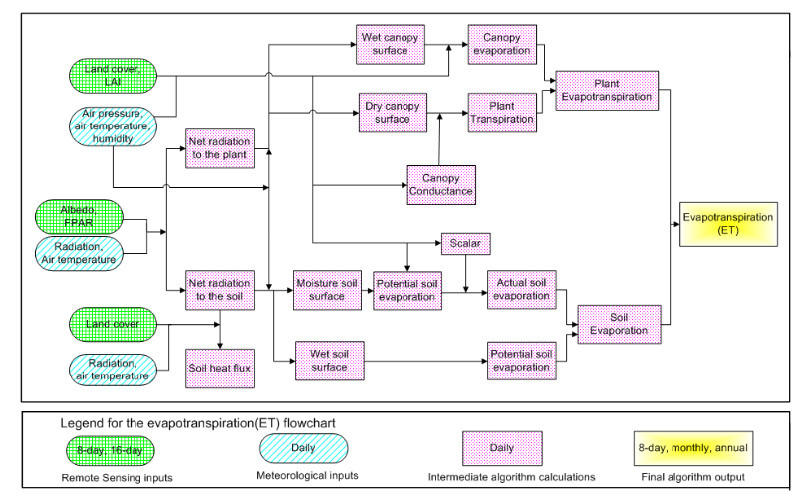
ET algorithm logic
$$λE ={λE}_{wetC}+{λE}_{trans}+{λE}_{soil}$$
Mu, et al. 2011
Notes:
Diagram shows data inputs and intermediate calculations that go into determining ET.

Slide 7
Data sources
MODIS data
Meteorological data
Land cover type (MOD12Q1)
FPAR & LAI (MOD15A2)
albedo (MOD43C1)
Linear interpolation used to fill missing/unreliable data
1.0 ° × 1.25° GMAO
solar radiation
air temperature
air pressure
humidity
non-linearly interpolated to 1km² pixel level based on four surrounding pixels

Slide 8
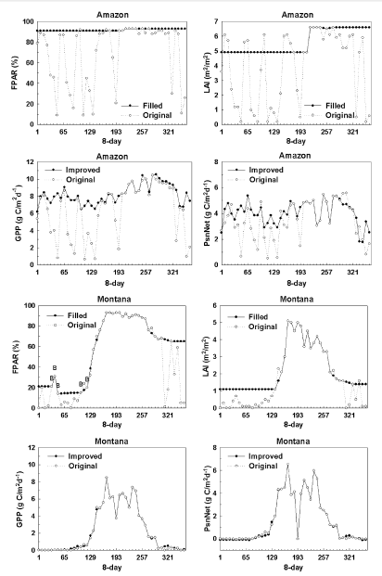
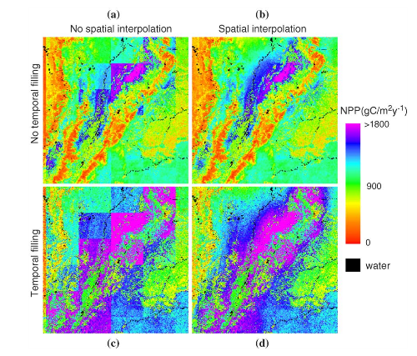
Gap filling & Interpolation
Zhao, et al. 2005
Notes:
Figures from 2005 paper that describes the gap filling and interpolation methods used on the input data.
The FPAR/LAI product has quality assessment fields denoting cloudiness, presence of snow/ice, and the algorithm employed.
FPAR/LAI values retrieved by the main algorithm (the radiation transfer process) are the most reliable, and those retrieved by the back-up algorithm (the empirical relationship between FPAR/LAI and NDVI) are less reliable because the back-up algorithm is employed mostly when cloud cover, strong atmospheric effects, or snow/ice are detected.
For LAI & FPAR, data retrieved during periods without clouds and derived by the radiation transfer algorithm are considered reliable.
Use linear interpolation to fill unreliable or missing data based on reliable FPAR/LAI data. If the first or last day is missing, it is replaced with the nearest reliable data value. Then all other missing/unreliable data are replaced by linear interpolation.
Meteorological data is obtained at a 1x1.25 degree resolution. Each 1km pixel falling into the same meteorological grid cell inherits the same met data, creating a noticeable footprint. At global or regional scale, less important, but at a local scale, in terrain with topographical variation, or regions with abrupt climate gradients, it may cause large inaccuracies.
To enhance the meteorological inputs, they used a non-linear spatial interpolation technique using the four closest GMAO grid cells for each 1km MODIS pixel. This technique removes the abrupt changes from one grid to the next. Compared it with World Meteorological Organization daily surface weather stations (>5000 stations), and found much better agreement→ concluding that the interpolation greatly improves the met inputs.
LEFT FIG: top (no linear filling)→ low NPP values, left (no interpolation): noticeable grid footprints.

Slide 9
MODIS Land Cover Type
Biome Properties Look-Up Table (BPLUT)
Mu, et al. 2011

Slide 10
MODIS FPAR & LAI
Fraction of absorbed photosynthetically active radiation (FPAR) used as surrogate for vegetative cover fraction (F_{C})
$$F_{C}=FPAR$$
Leaf area index (LAI) used to scale leaf-scale parameters to canopy-scale

Slide 11
MODIS Albedo
Used to calculate net radiation (R_{net})
$$Rnet=\left(1−α\right)×R_{S↓}+\left(ε_{a}−ε_{s}\right)×σ×T4$$
Then to calculate A for the vegetation canopy and soil:
$$A=Rnet$$
$$AC=FC×A$$
$$ASOIL=\left(1−FC\right)×A−G$$

Slide 12
ET components
$$λE ={λE}_{wetC}+{λE}_{trans}+{λE}_{soil}$$
partitioned using vegetation fraction estimated from FPAR
wet canopy fraction (Fwet) estimated from relative humidity
$λ$E_{trans} → (1- Fwet)
$λ$E_{soil} = $λ$E_{sat} + $λ$E_{moist}

Slide 13
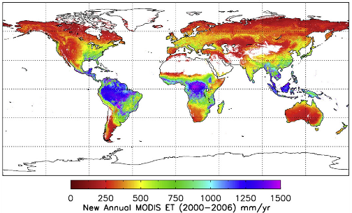
Results
Mu, et al. 2011
Notes:
Average annual 2000-2006 is 568 +/- 378mm/year, up from 416 +/- 337mm/year.
Taking into account that 24% of the land surface is classified as barren/desert, & assumed to have ET == 0, the average ET estimate across all land surfaces is 431.68 mm/year.
Over the entire land surface, precip averages 750mm/year. Studies have shown that ET returns more than 60% of precip on land back to the atmosphere. 750*60% = 450 mm/year.

Slide 14
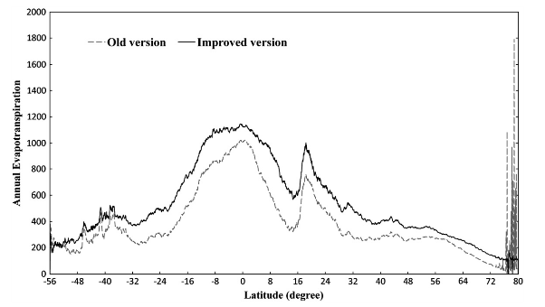
Old version vs. improved version
Mu, et al. 2011
Notes:
New algorithm more sophisticated than previous version.
Improvements over previous version:
simplification of vegetation cover fraction
calculating ET as the sum of daytime and nighttime components
calculating soil heat flux
improving methods to estimate stomatal conductance, aerodynamic resistance, and boundary layer resistance
including both wet canopy evaporation and dry canopy transpiration
soil evaporation includes both PET from saturated soil surface and actual evaporation from moist surface

Slide 15
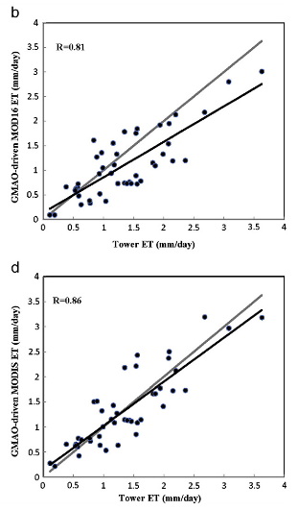
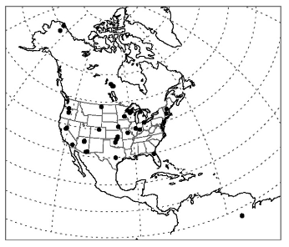
Comparison with flux towers
Mu, et al. 2011
Notes:
46 flux towers used for validation
improved performance over previous version:
improved algorithm better captures magnitudes of ET measurements
within 10-30% accuracy of ET observations
mean annual bias = 0.33mm/day

Slide 16
Uncertainties
Input data uncertainties
Inaccuracies in measured data
Flux tower vs. MODIS footprint size
Algorithm limitations/assumptions
Land cover misclassifications
Notes:
Quality controlled/gap filled, but filled values are artificial and contain uncertainties. Original met data at coarse resolution– spatial interpolation helps, but contains uncertainties.
Known energy balance closure issue w/ eddy covariance measurements. Underestimate ET by 10-30%. Data needs to be gap-filled and corrected for energy balance closure. No uniform method– may contain uncertainties.
Flux tower footprint = field scale, homogeneous terrain, vegetation. Compared to MODIS 9km² footprint– heterogeneous land cover and terrain.
Algorithm doesn’t account for stand age, disturbance history, or species composition. Biome parameters are set constant globally.
If pixel misclassified, will be given the wrong set of biome parameters.

Slide 17
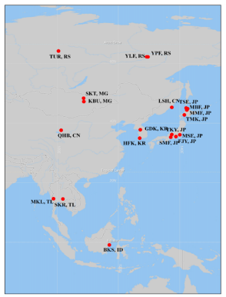
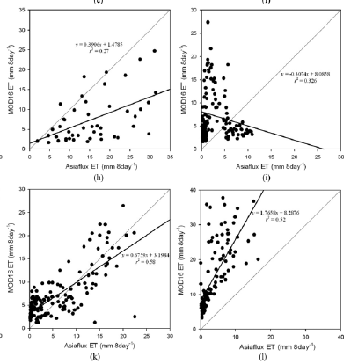
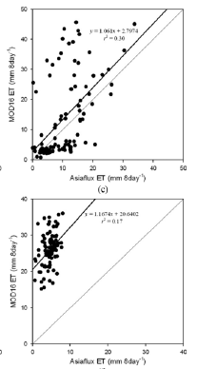
Notes:
rice paddy alpine grassland rice paddy
deciduous forest deciduous forest tropical forest
average bias (mm/8day) ranged from 0.17 mm/8day to -21.41 mm/8day
Did not correct tower measurements for energy balance closure.
Best performances at forest sites, generally mismatched at grassland sites

Slide 18
Conclusions
MOD16 useful tool for examining global terrestrial water and energy cycles, and environmental change.
At smaller spatial scales, there may be biases between MOD16 and surface measurements.
Validation using surface measurements.

