Slide 1
Introduction to Landsat 8 Satellite Image Analysis
Seung Hyun (Lucia) Woo
June 20th, 2013
Yale University

Slide 2
Outline
Negative Reflectance
Greater than 1 Reflectance
Cyan Pixels
Sensor Saturation
ENVI Service Pack 3
Calibration Errors
Cirrus Band
TIR Bands

Slide 3
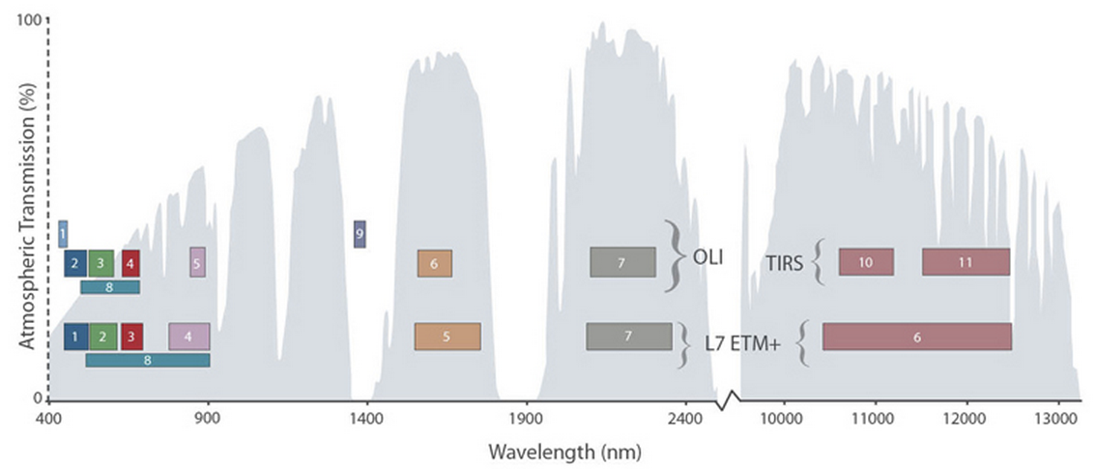
Landsat 8 vs. Landsat 7
Coastal
Aerosol
Cirrus
2 Thermal Bands
Notes:
New Bands: Coastal Aerosol, Cirrus, and 2 thermal bands
Shorter panchromatic, NIR, and MIR ranges.
Higher image quality – Crisper (12 bit vs. previous 8 bit)

Slide 4
Negative Reflectance
DN to Reflectance Conversion:
Most of the negative reflectance values came from the triangular border regions.
White pixels: DN=0 on ALL bands
Notes:
Negative reflectivity – Physically impossible

Slide 5
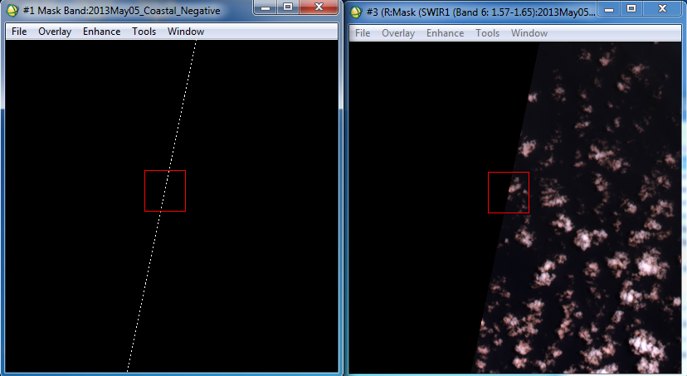
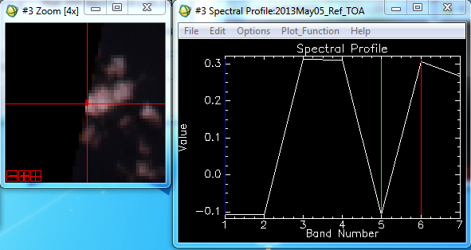

Slide 6
Negative Reflectance
Recommended Preprocessing Step: Create a mask for DN=0 on ANY band
Even after the mask, some negative pixels remain, notably in the interior of the images. These negative pixels have DN value greater than 0 but less than 5,000.
Highest number of negative reflectivity pixels found in the cirrus band, then the coastal band
Found in areas of low reflectivity. Ex. Bodies of water such as ocean and water channels

Slide 7
Greater than 1 Reflectance
Unlike negative reflectivity, greater than 1 reflectivity is not unnatural 1. Nearby thunderstorm clouds that provide additional illumination from reflected solar radiation
2. The surface receiving radiation is directly perpendicular to the sun.
Most pixels found among cloud pixels
- Exception: Occasional white rooftop pixels have>1 reflectivity in the MIR bands

Slide 8
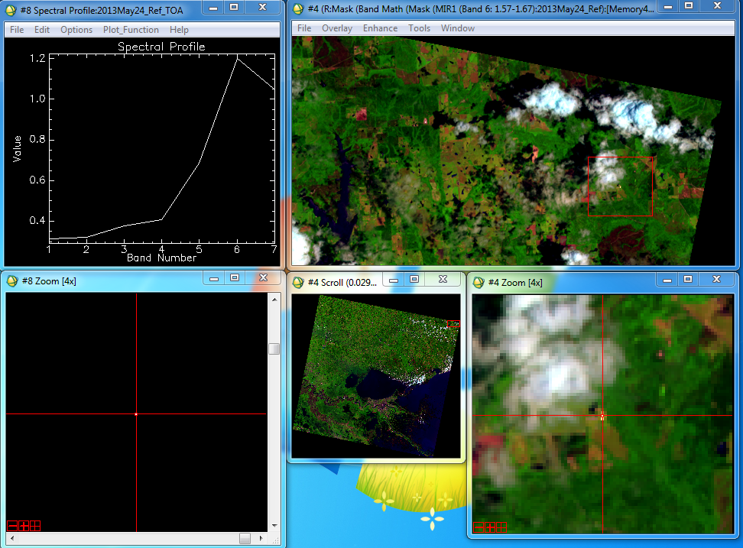
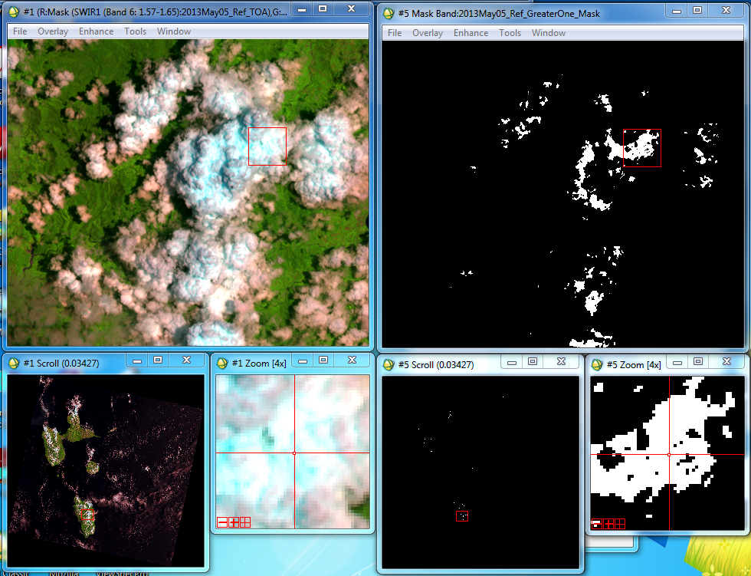
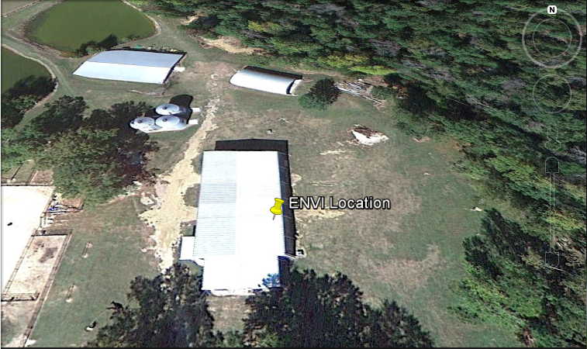
654 – RGB Mask for >1 Reflectance

Slide 9
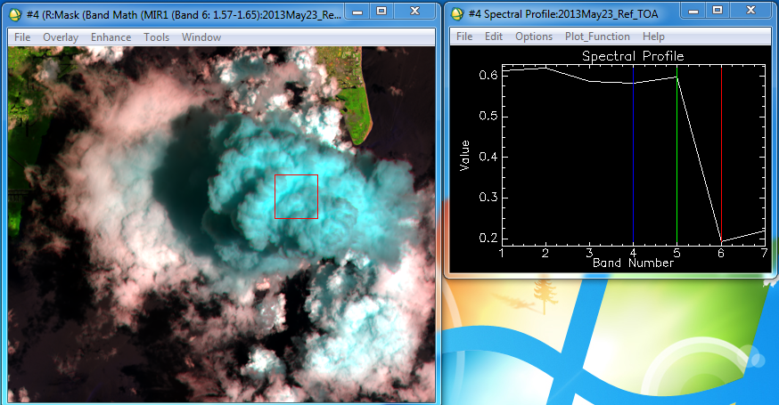
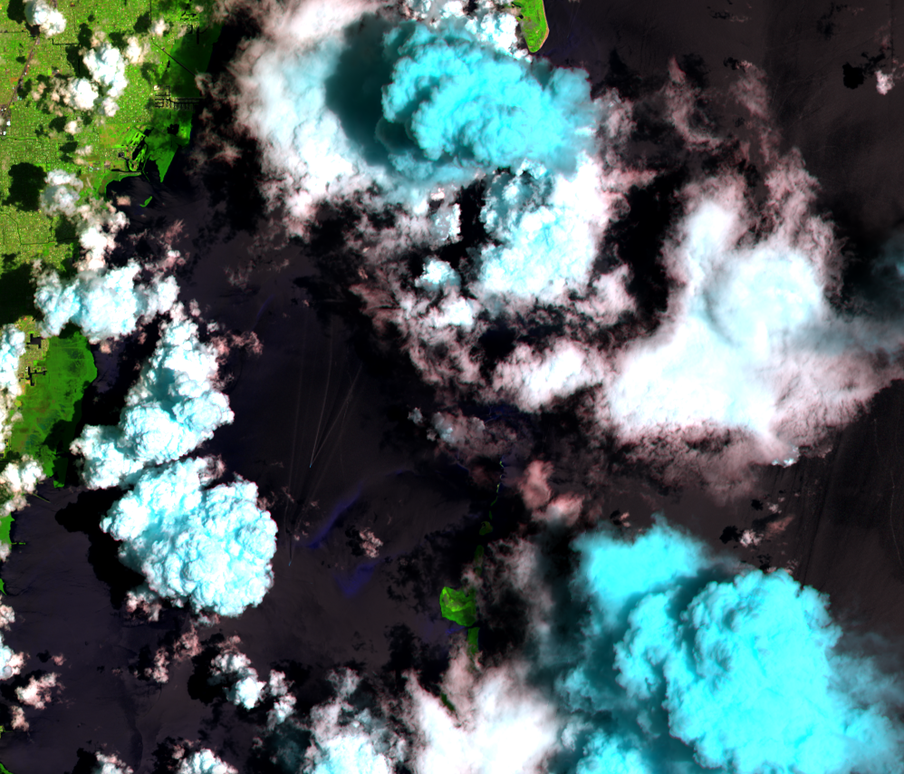
Cyan Cloud Pixels
654 - RGB
-Cyan pixels indicate ice.
-White pixels indicate liquid droplets.

Slide 10
Sensor Saturation
Dominica: 2013May05_Ref_TOA
 |  | MODE |  |  | MAXIMUM
 | Reflectance | DN | # of Pixels | Reflectance | DN | # of Pixels
Band 1 | 1.001898 | 51334 | 94 | 1.190295 | 60047 | 1
Band 2 | 1.000127 | 51252 | 276 | 1.257111 | 63137 | 1
Band 3 | 1.003319 | 51400 | 259 | 1.308963 | 65535 | 1
Band 4 | 1.003319 | 51400 | 491 | 1.308963 | 65535 | 12
Band 5 | 1.003319 | 51400 | 1352 | 1.308963 | 65535 | 64
Band 6 | 1.027111 | 52500 | 1 | 1.027111 | 52500 | 1
Band 7 | N/A | N/A | N/A | N/A | N/A | N/A
For Landsat 8 images, the DN maximum value is 65535, indicating sensor saturation. These pixels are found in the clouds.
Note sensor saturation for Bands 4 and 5
Curiously, both scenes of Alaska (snow caps) and Florida (thunderstorm clouds) did not demonstrate sensor saturation.

Slide 11
Service Package 3 (SP3)
Automatic Conversion Step (Looked at only reflectance)
Characteristics:
- Pixels in the triangular border regions have values of zero on ALL bands
- No negative reflectance value. All those negative pixels have values of zero.
- Does not incorporate solar angle in its calculations
where:
ρλ = TOA planetary reflectance, without correction for solar angle. M_{ρ} = Band-specific multiplicative rescaling factor from the metadata (REFLECTANCE_MULT_BAND_x, where x is the band number) A_{ρ} = Band-specific additive rescaling factor from the metadata (REFLECTANCE_ADD_BAND_x, where x is the band number) Q_{cal} = Quantized and calibrated standard product pixel values (DN) θ_{SE} = Local sun elevation angle. The scene center sun elevation angle in degrees is provided in the metadata (SUN_ELEVATION).
(Source: USGS)

Slide 12
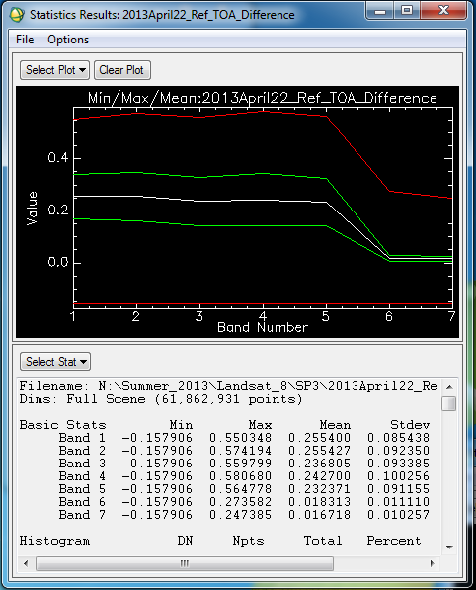
Service Package 3 (SP3)
Near the poles, the absence of solar angle makes a substantial difference (~0.25) in the visible band spectrum.
Ex. Alaska
Band Math: B1-B2
B1=Manually calculated TOA with SE
B2=SP3 generated TOA

Slide 13
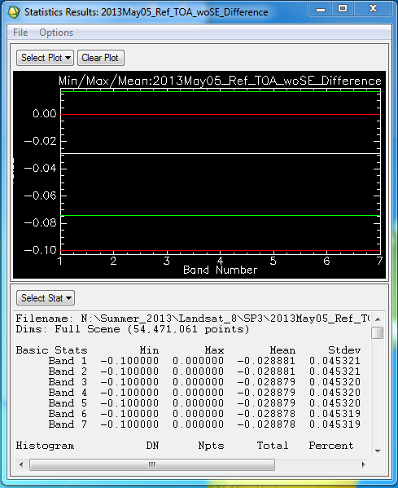
Service Package 3 (SP3)
But, even after taking out the solar angle component, there is a constant offset.
This offset is fortunately small (~0.03).
Note: Mask for DN=0 on ALL bands

Slide 14
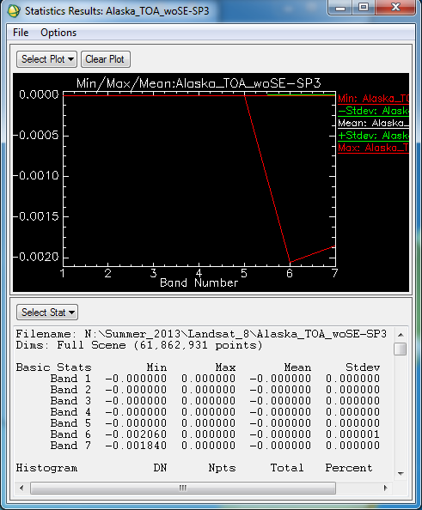
Service Package 3 (SP3)
Once the mask for DN=0 on ANY band is applied, the differences between the manual and SP3 calculated reflectance values (still not accounting for solar angle) are almost negligible.
Take Away Points:
Mask for DN=0 on ANY band highly recommended before processing
SP3 is a reliable tool for DN to reflectance conversion IF one disregards solar angle.
For regions close to the poles where solar angles are substantially smaller, one should be cautious to use SP3 reflectance values.

Slide 15
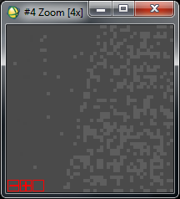
Calibration Errors
- Cirrus Band
Notes:
5052-5062 across the boundary/ 10-15 units of difference in the DN values

Slide 16
Calibration Errors
- TIR Band
Band 10 – TIR 1 (10.60-11.19) Band 11 – TIR 2 (11.50-12.51)
Notes:
22726-23486 across the boundary. The differences are bigger than the cirrus (700-800 units in the DN)

Slide 17
Looking Ahead
Albedo calculations: Liang’s vs. Smith’s
Transects with Cirrus Band (Reflectance, NDVI, Albedo, Temperature)
Coastal Aerosol Band

